Slide 1
Cos’è il cambiamento climatico?
«Per “cambiamenti climatici” si intendono i cambiamenti a lungo termine delle temperature e dei modelli meteorologici. »
Cit. Nazioni Unite - Centro Regionale di Informazioni
https://unric.org/it/che-cosa-sono-i-cambiamenti-climatici/

Slide 2
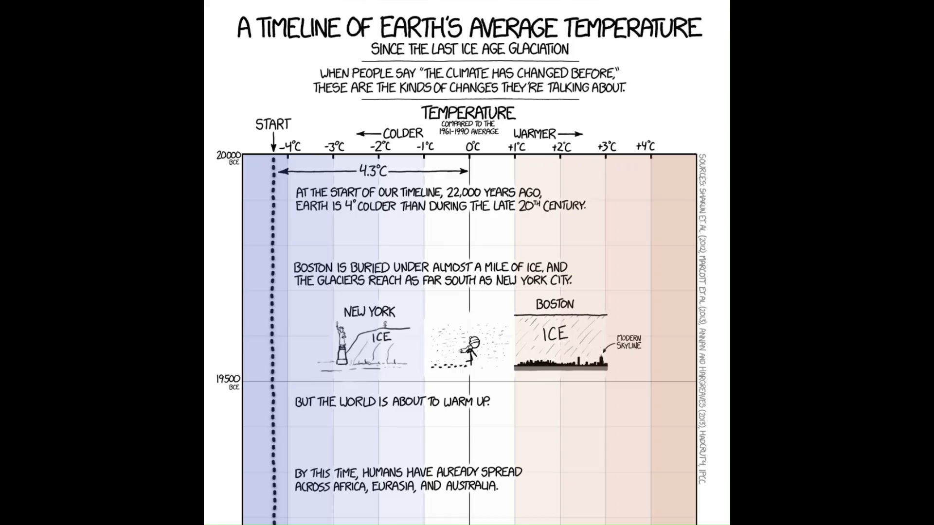
https://xkcd.com/1732/

Slide 3




🖼️ Framework scientifico
📩 Reperire i dati
⚙️ Analizzare i dati
🗺️ Visualizzare i risultati
🤔 Interrogarsi sui risultati

Slide 4

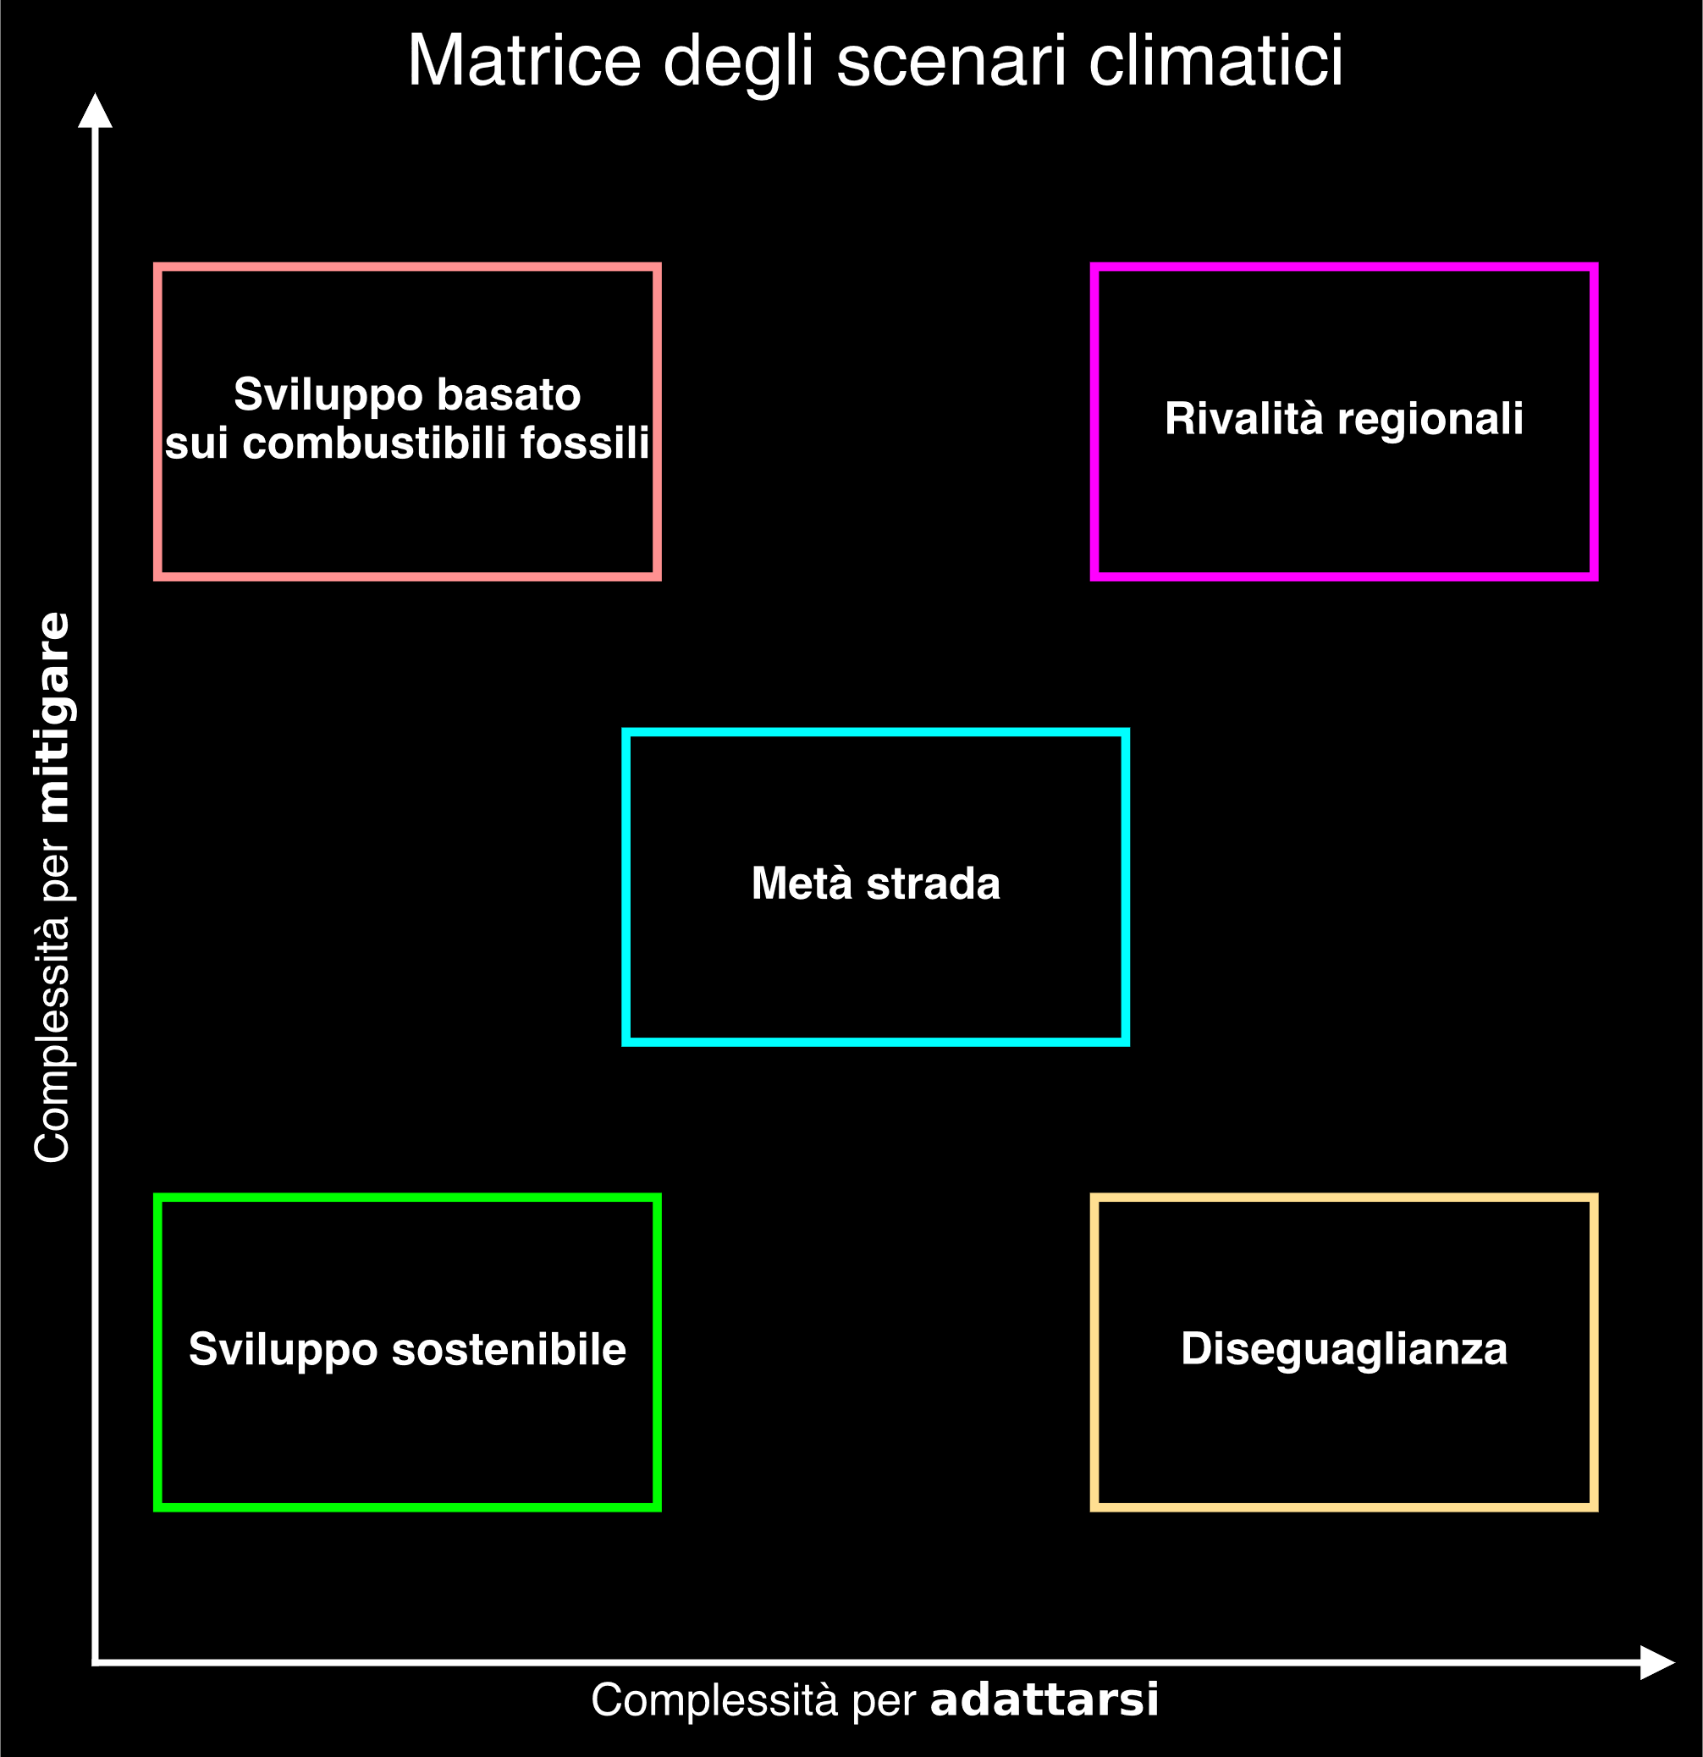

Slide 5
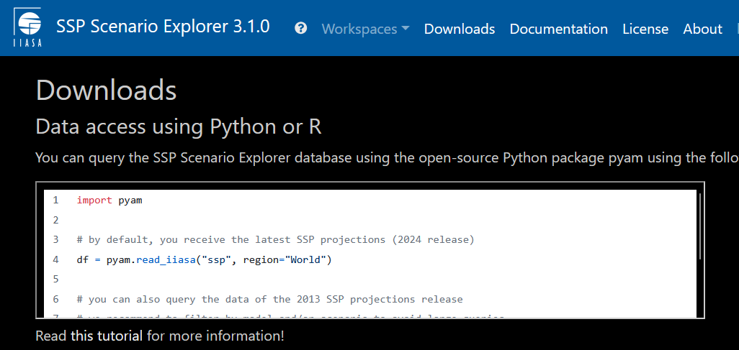

https://data.ece.iiasa.ac.at/ssp/#/downloads
© IIASA and contributing modeling teams 2024

Slide 8
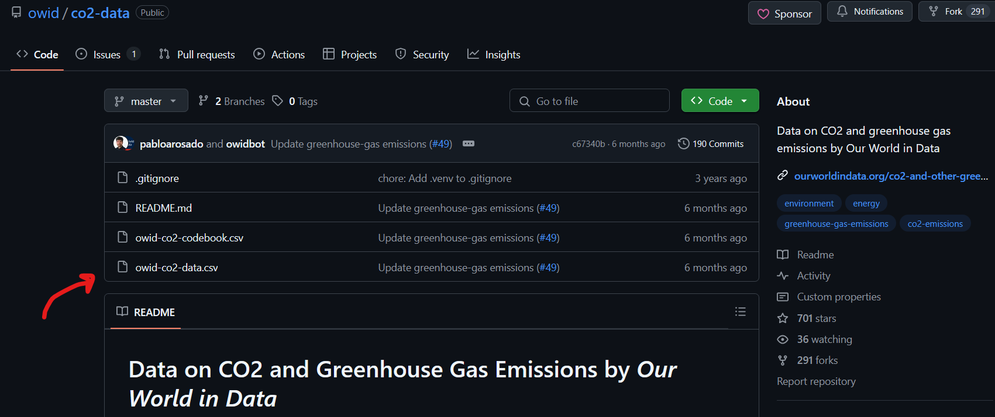
https://github.com/owid/co2-data
Hannah Ritchie, Pablo Rosado, and Max Roser (2023) - “CO₂ and Greenhouse Gas Emissions” Published online at OurWorldinData.org. Retrieved from: 'https://ourworldindata.org/co2-and-greenhouse-gas-emissions' [Online Resource]

Slide 10


Slide 11


Slide 12
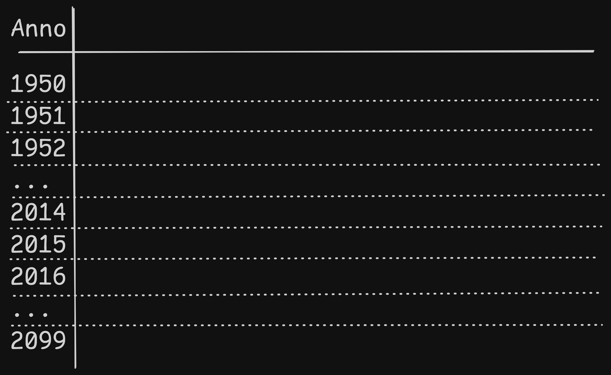

Slide 13
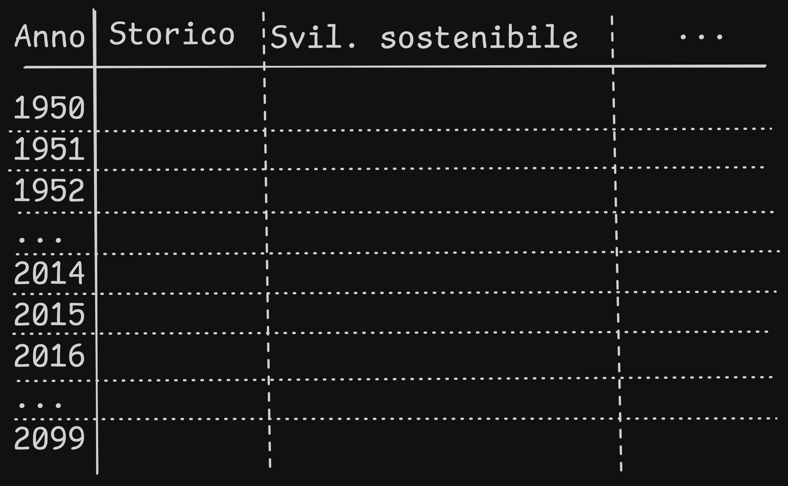

Slide 14
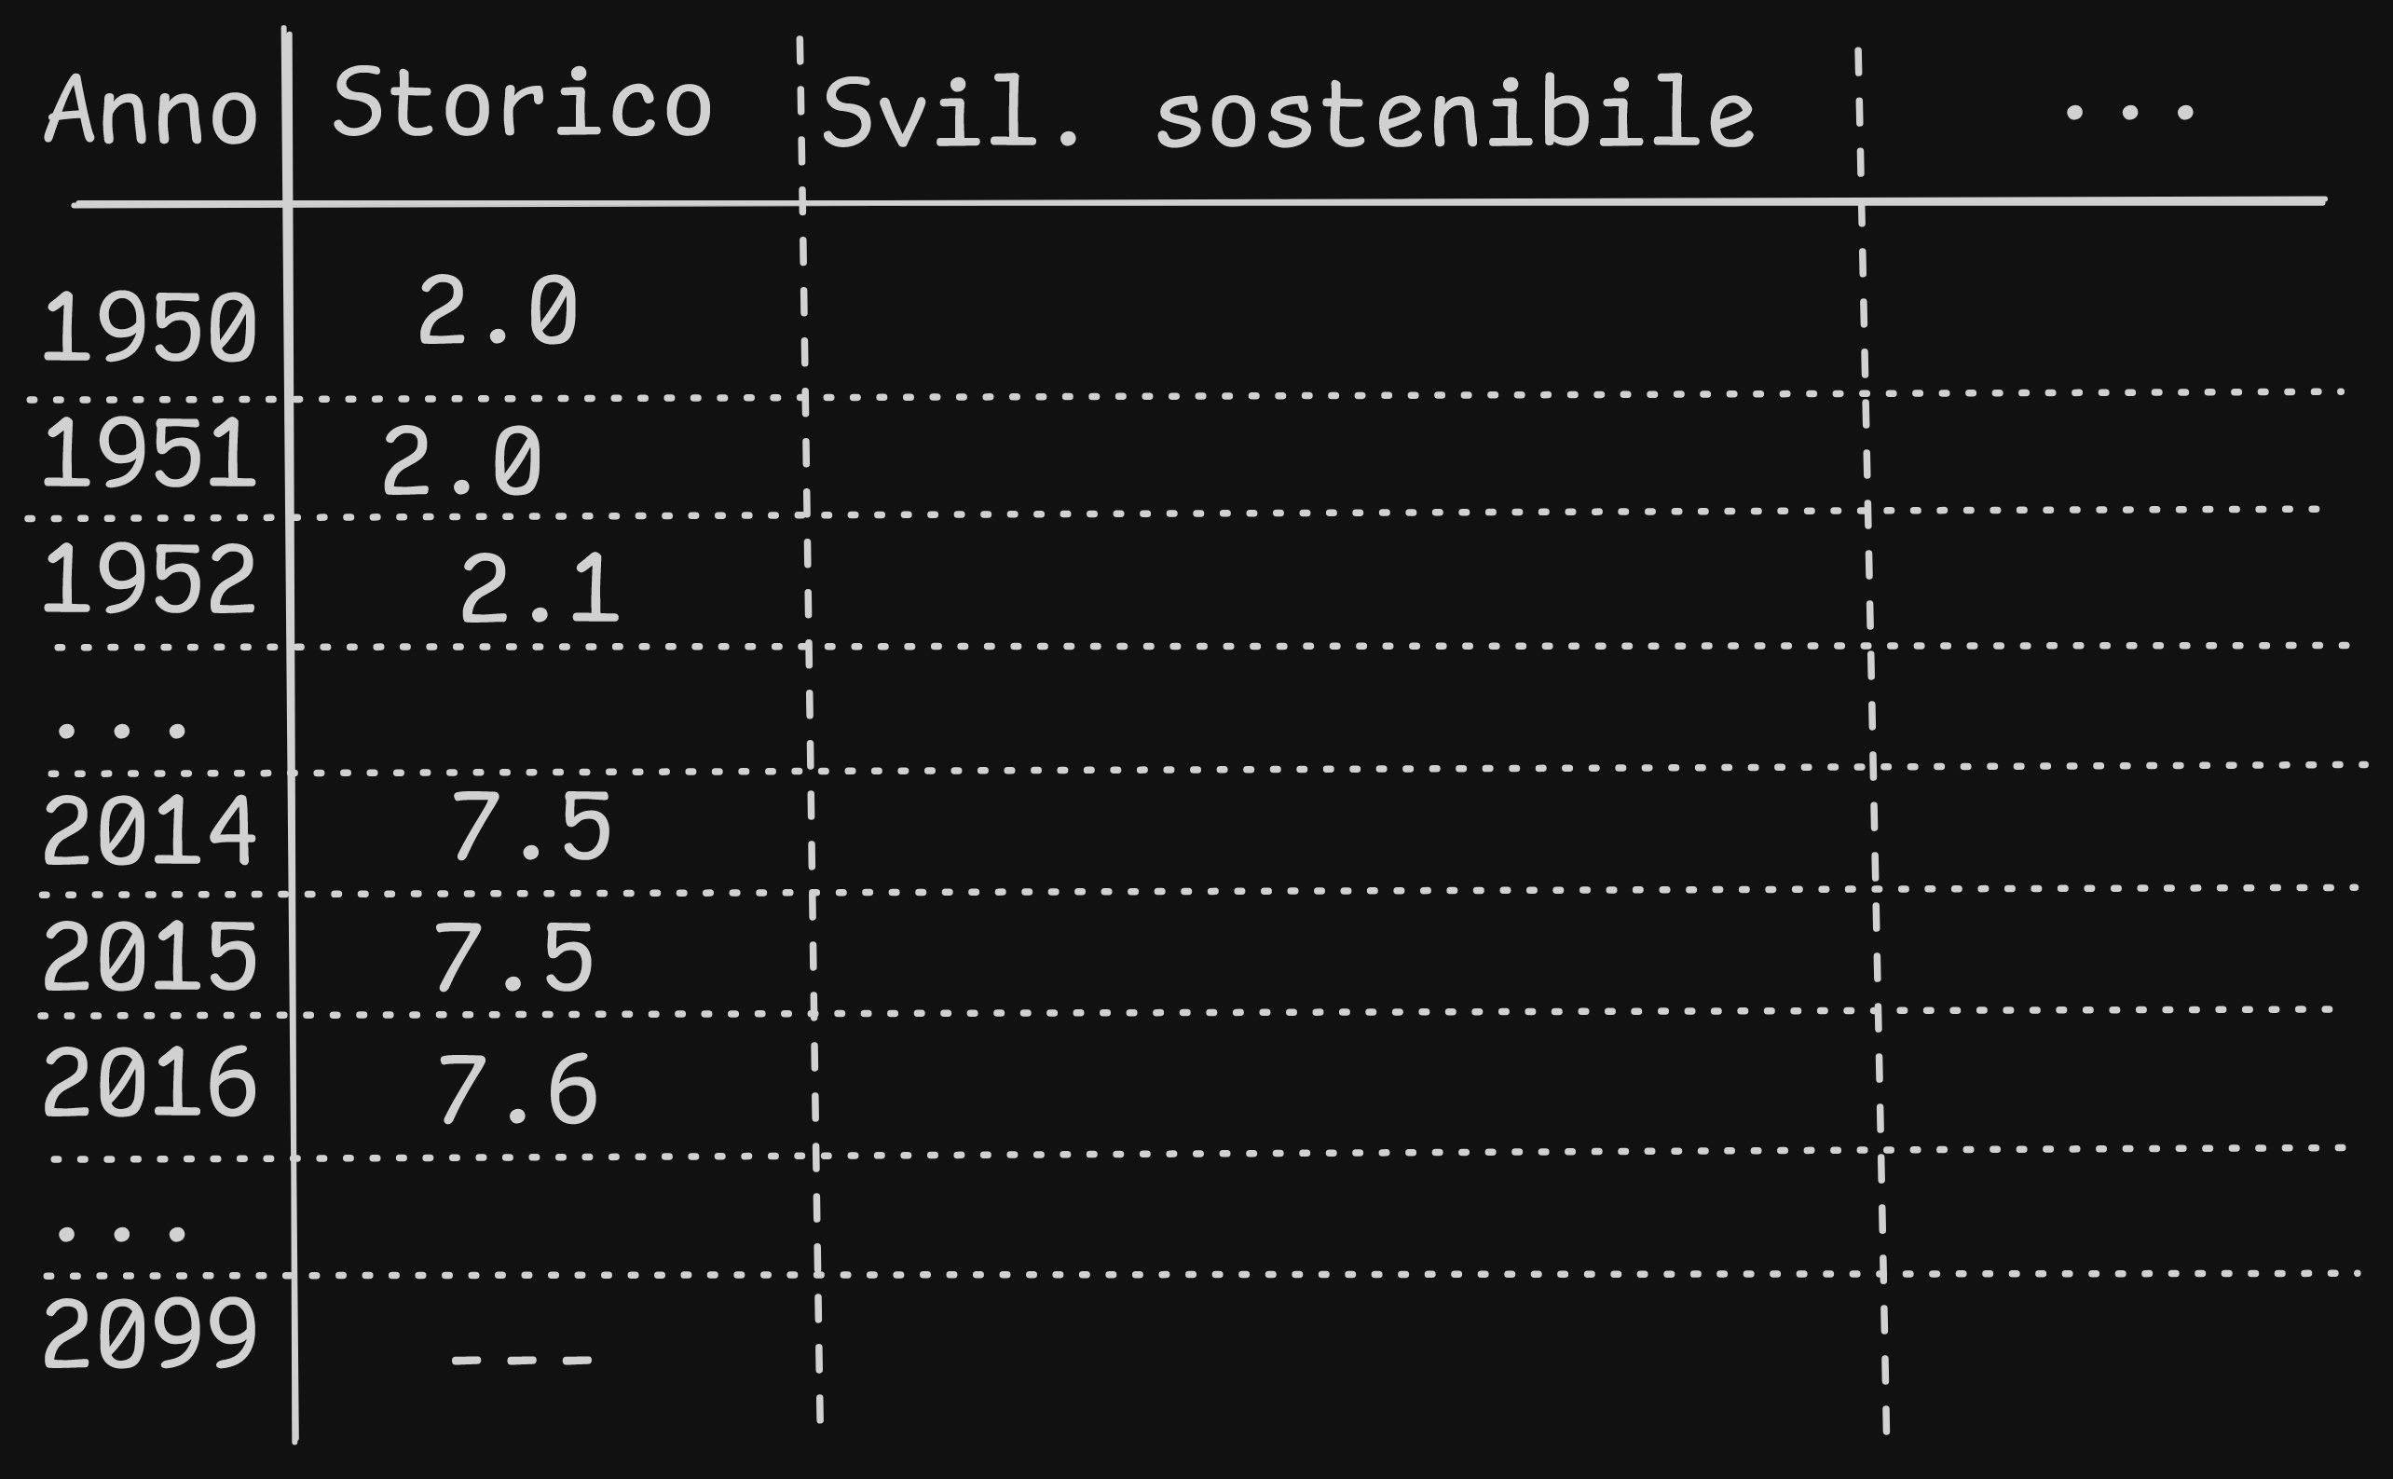

Slide 15


Slide 16
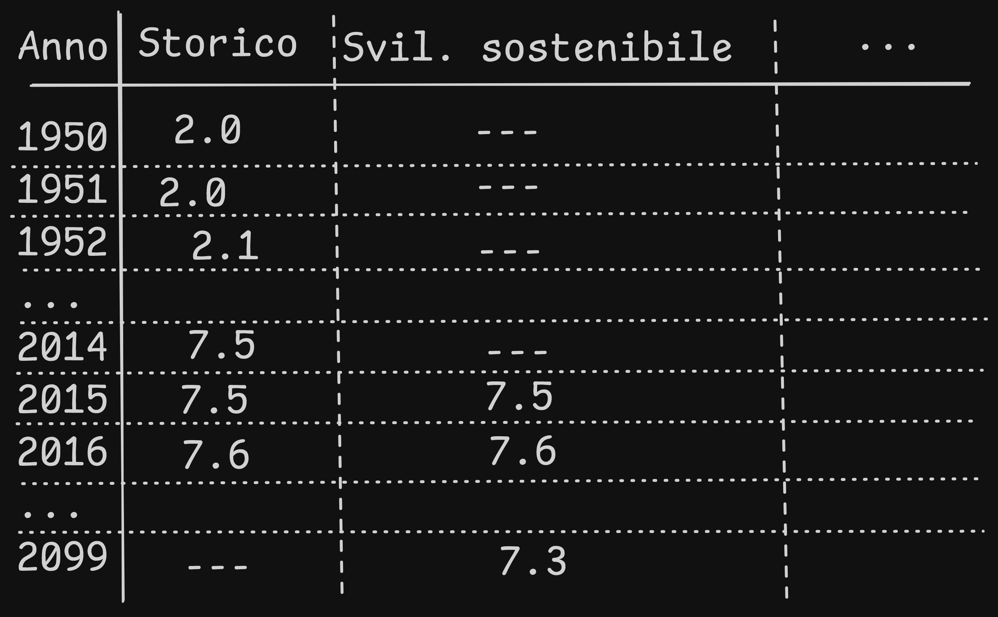
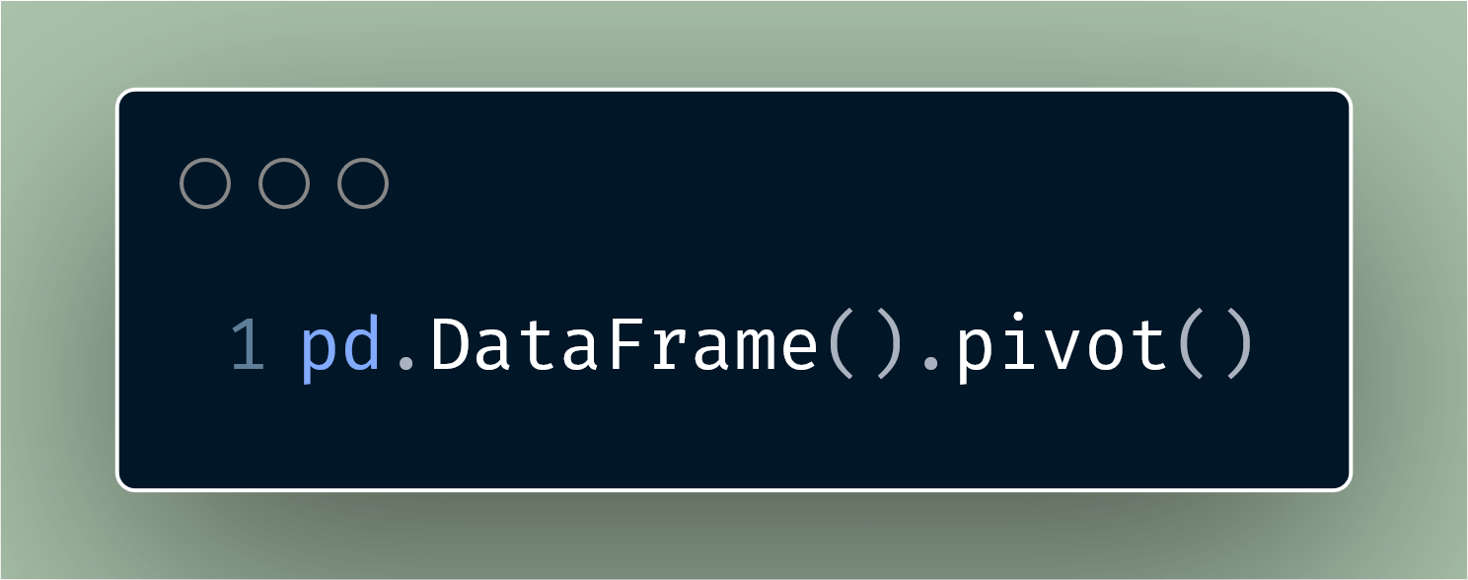

Slide 17
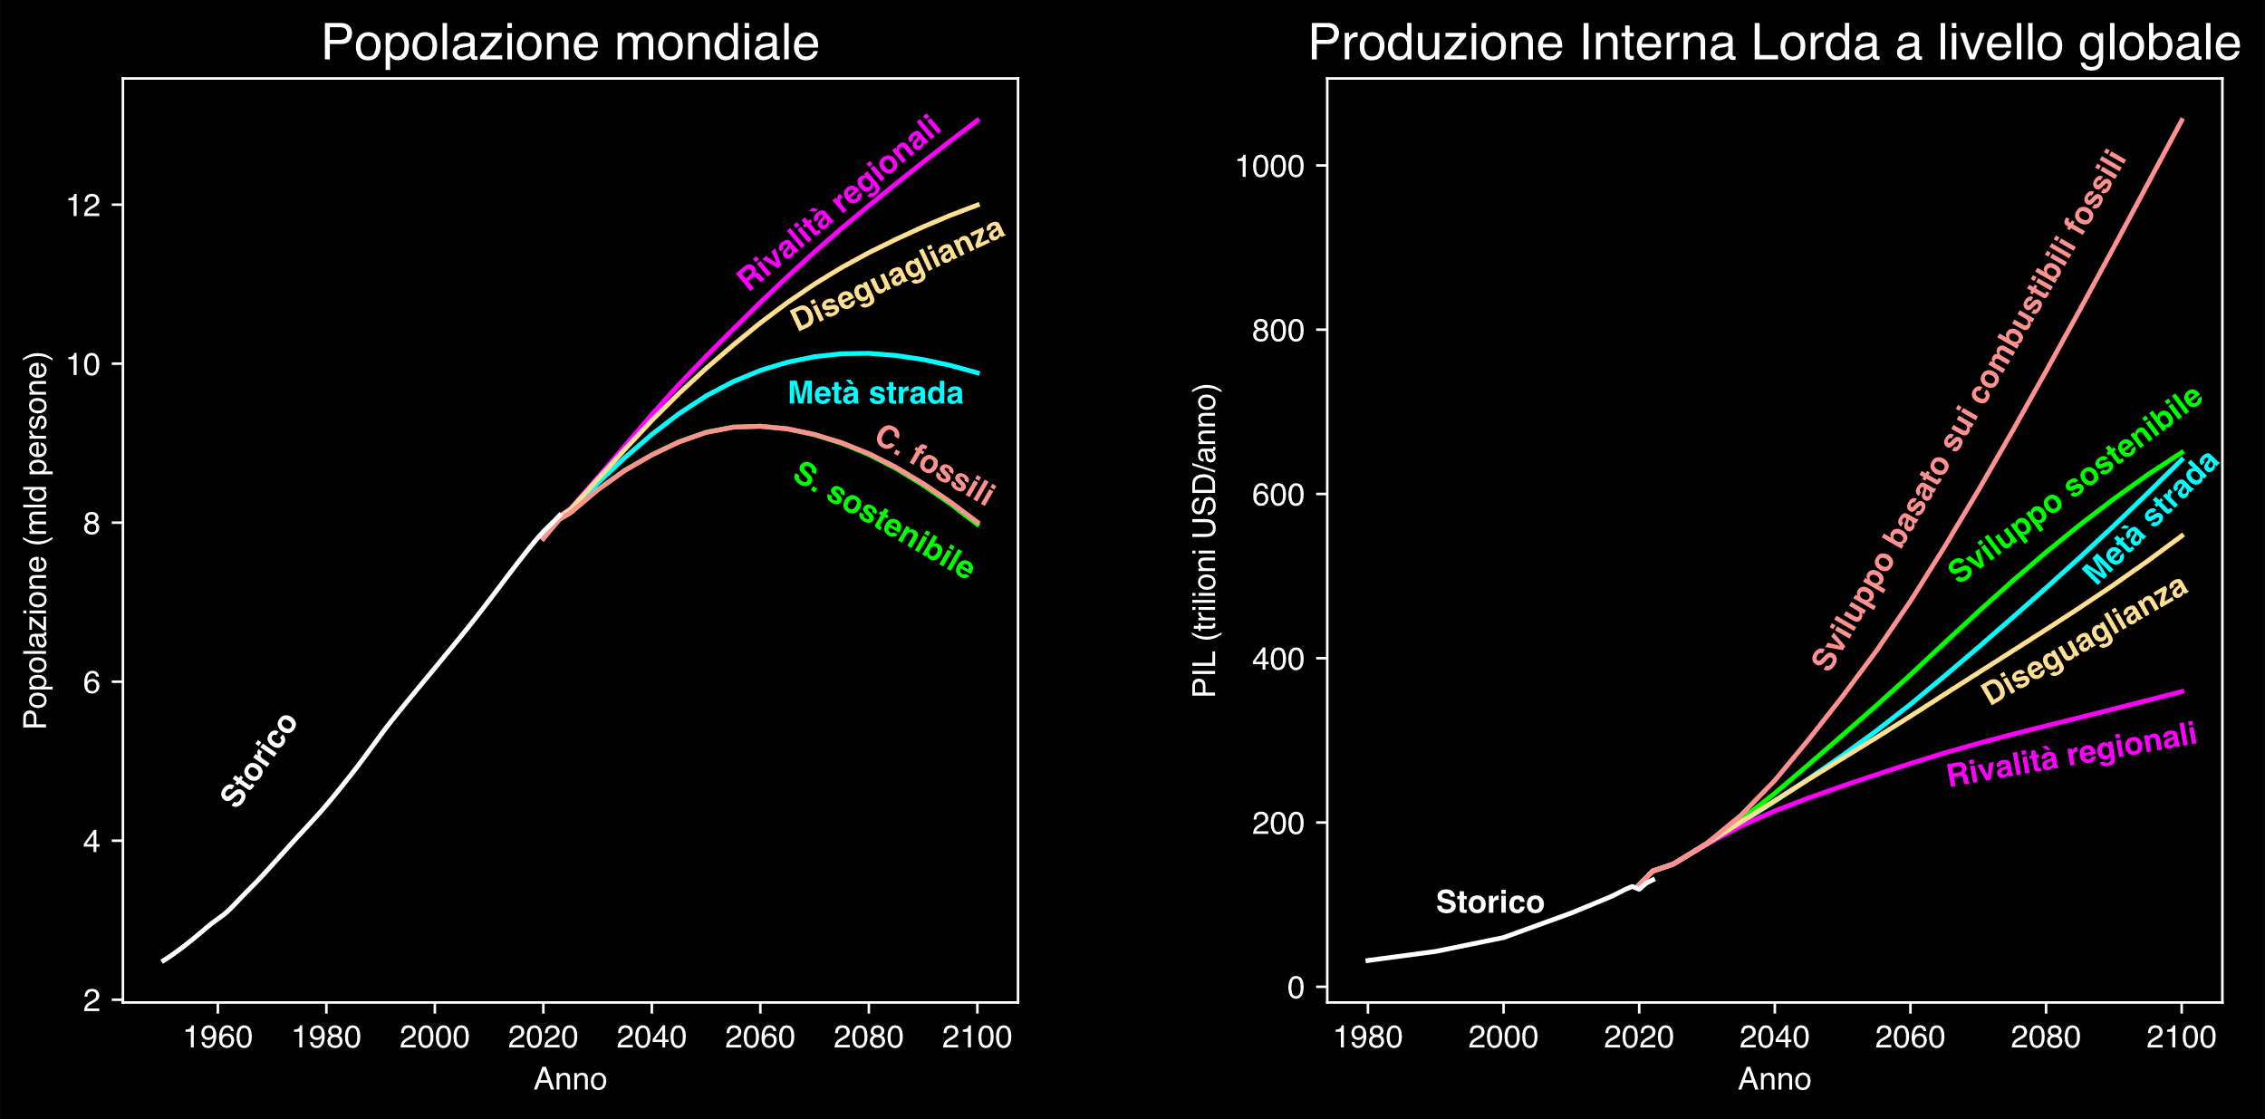
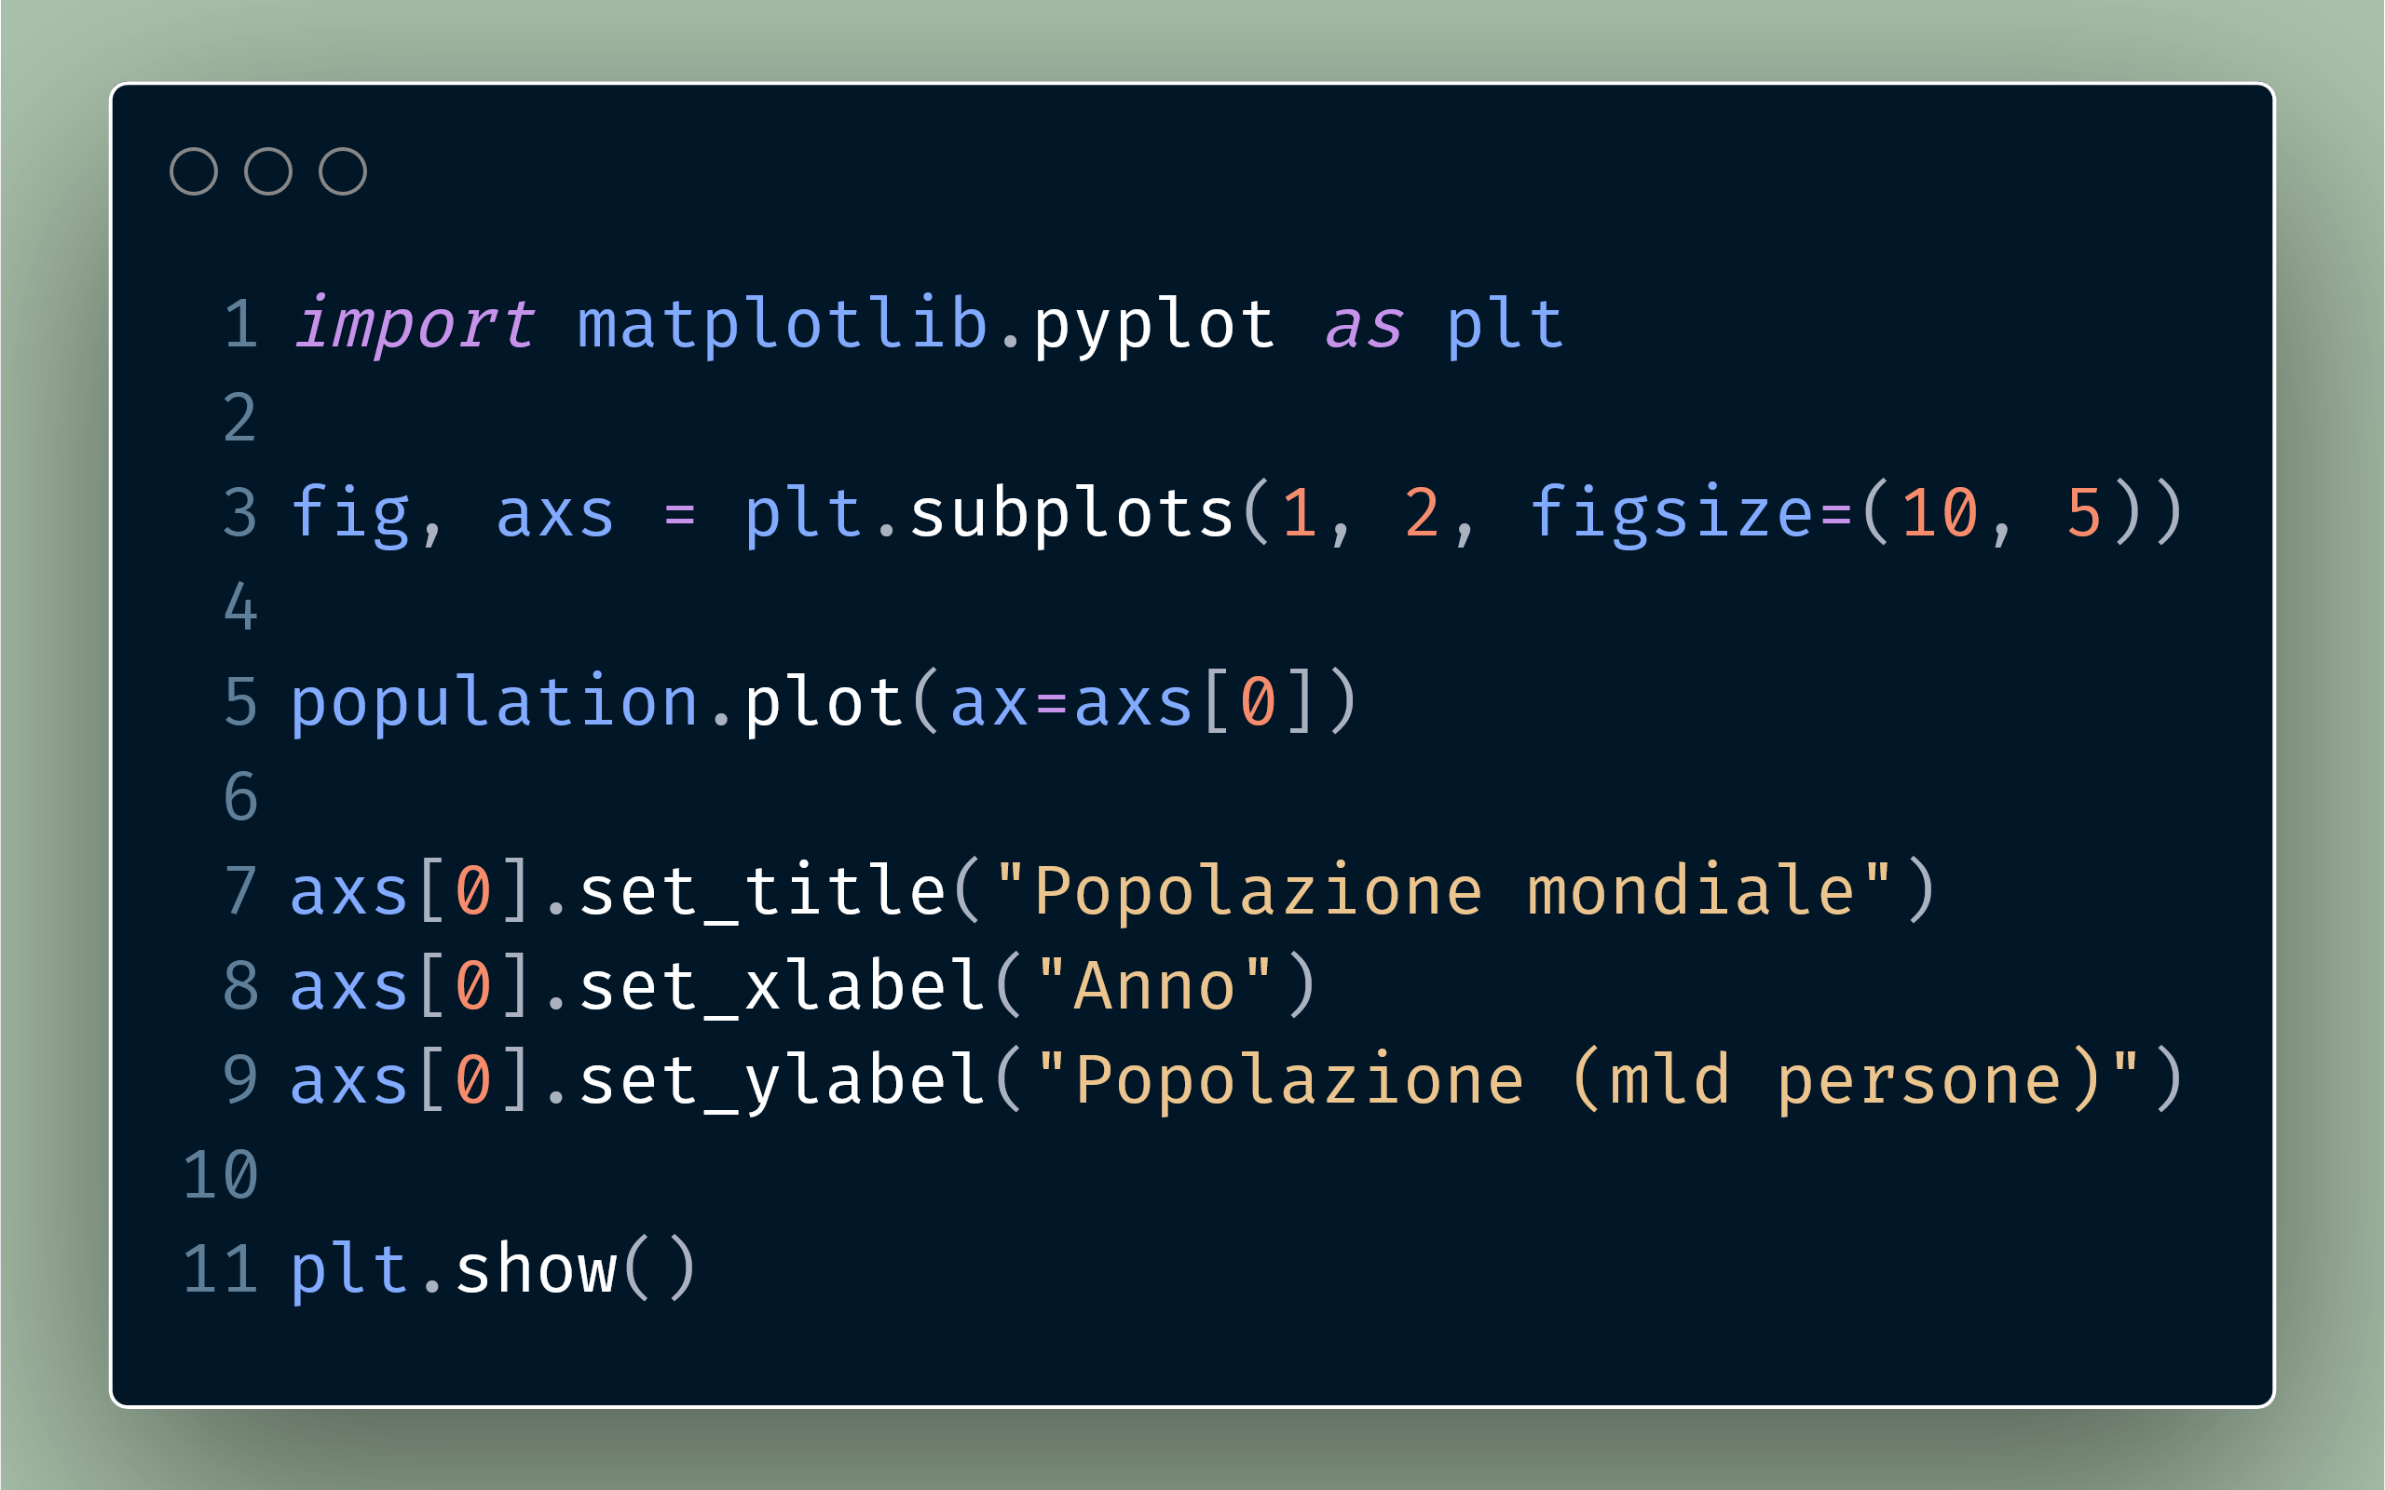
Hannah Ritchie, Pablo Rosado, and Max Roser (2023) - “CO₂ and Greenhouse Gas Emissions” Published online at OurWorldinData.org. Retrieved from: 'https://ourworldindata.org/co2-and-greenhouse-gas-emissions' [Online Resource]
© IIASA and contributing modeling teams 2024
K. Riahi et al.,

Slide 18
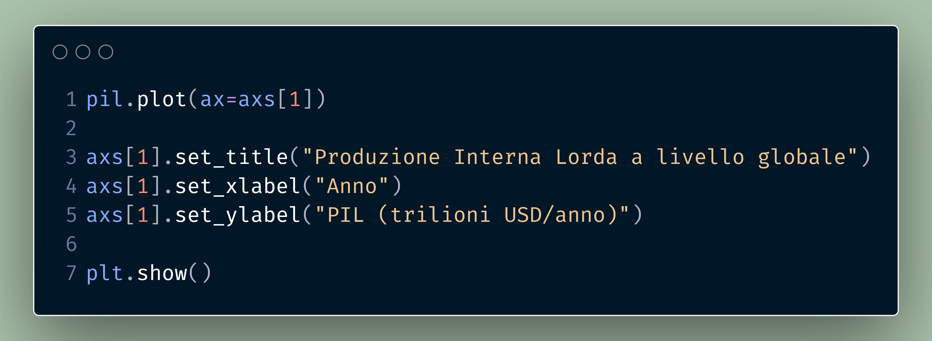
Hannah Ritchie, Pablo Rosado, and Max Roser (2023) - “CO₂ and Greenhouse Gas Emissions” Published online at OurWorldinData.org. Retrieved from: 'https://ourworldindata.org/co2-and-greenhouse-gas-emissions' [Online Resource]
© IIASA and contributing modeling teams 2024
K. Riahi et al.,

Slide 19
Hannah Ritchie, Pablo Rosado, and Max Roser (2023) - “CO₂ and Greenhouse Gas Emissions” Published online at OurWorldinData.org. Retrieved from: 'https://ourworldindata.org/co2-and-greenhouse-gas-emissions' [Online Resource]
© IIASA and contributing modeling teams 2024
K. Riahi et al.,

Slide 20
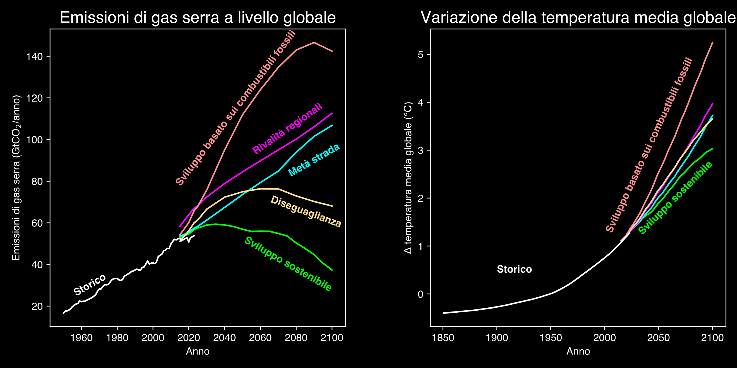
Hannah Ritchie, Pablo Rosado, and Max Roser (2023) - “CO₂ and Greenhouse Gas Emissions” Published online at OurWorldinData.org. Retrieved from: 'https://ourworldindata.org/co2-and-greenhouse-gas-emissions' [Online Resource]
© IIASA and contributing modeling teams 2024
K. Riahi et al.,

Slide 21
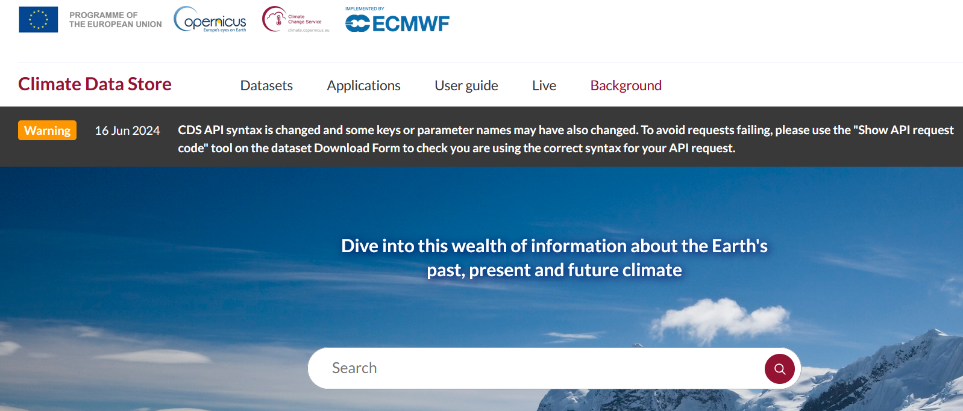
https://cds.climate.copernicus.eu/

Slide 22
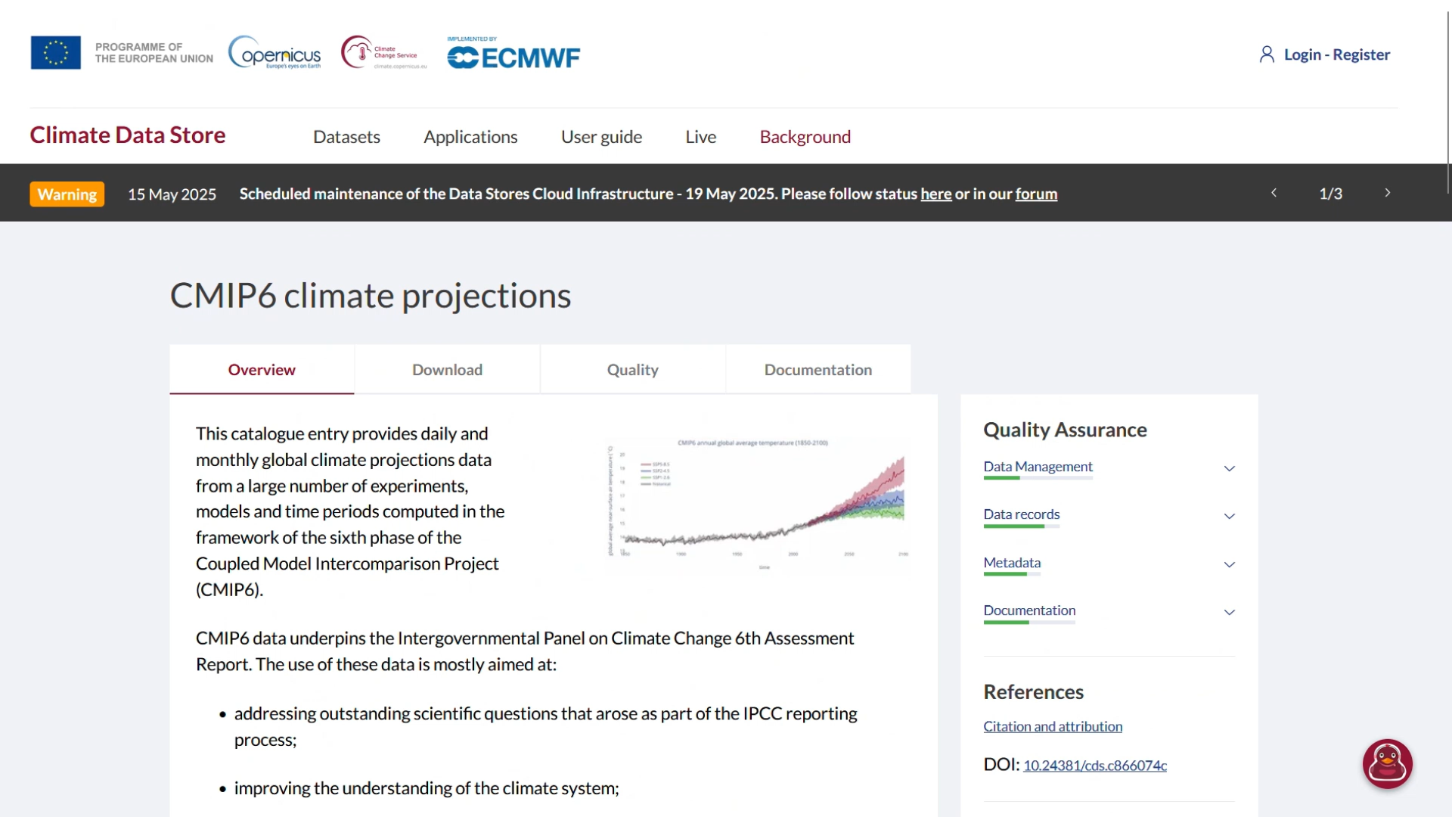

Slide 23
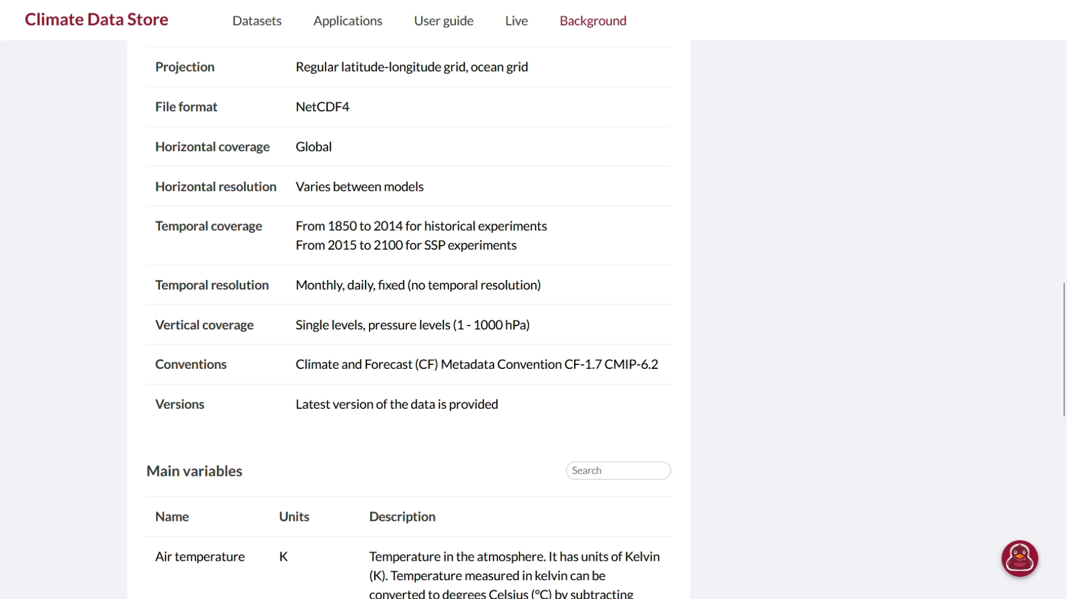

Slide 24
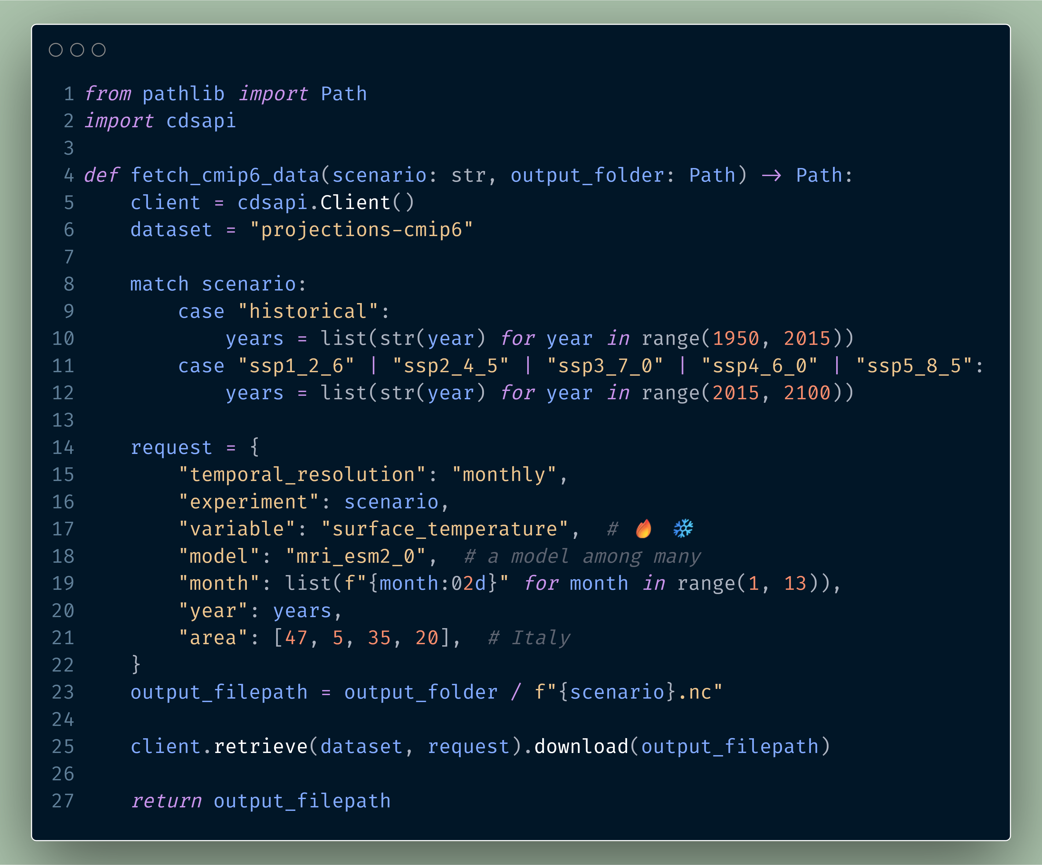

Slide 26
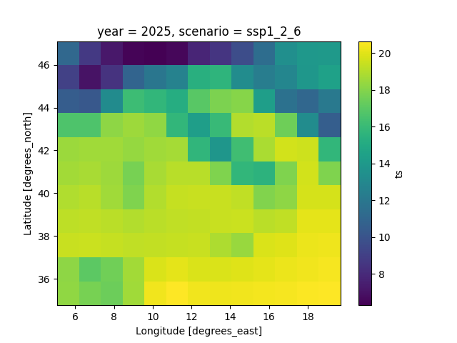
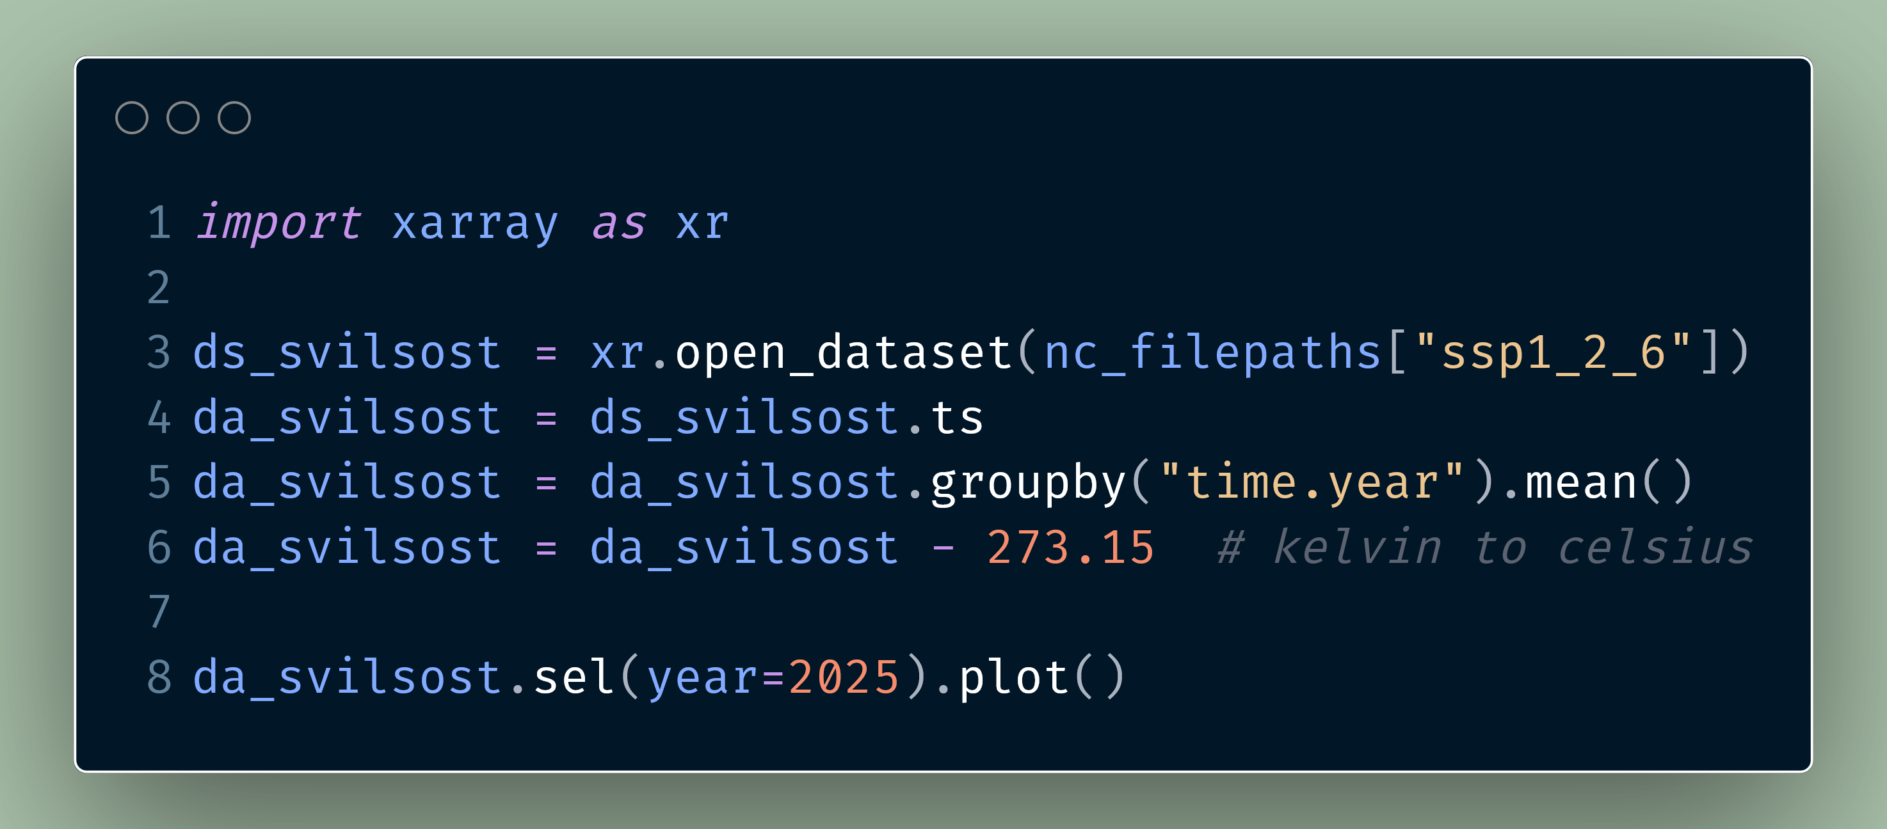

Slide 27
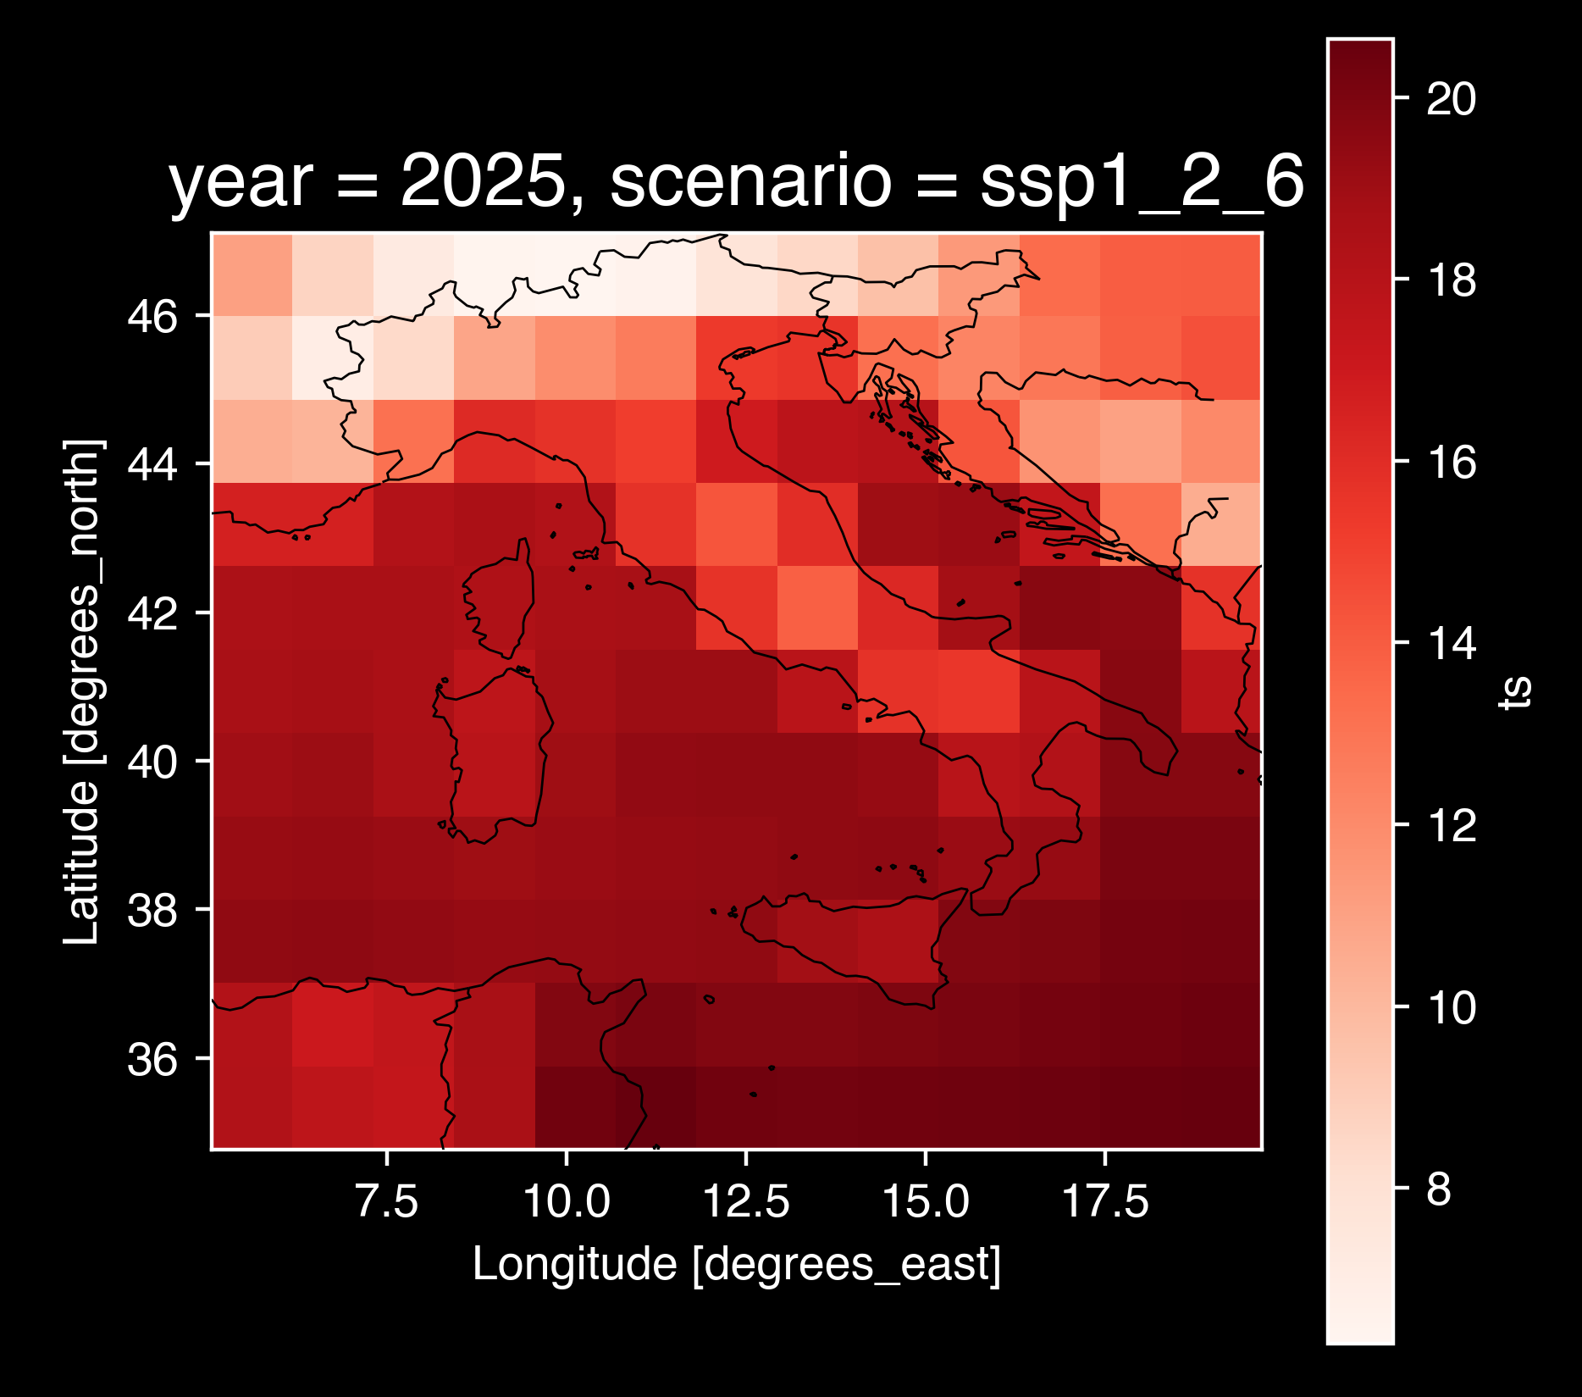
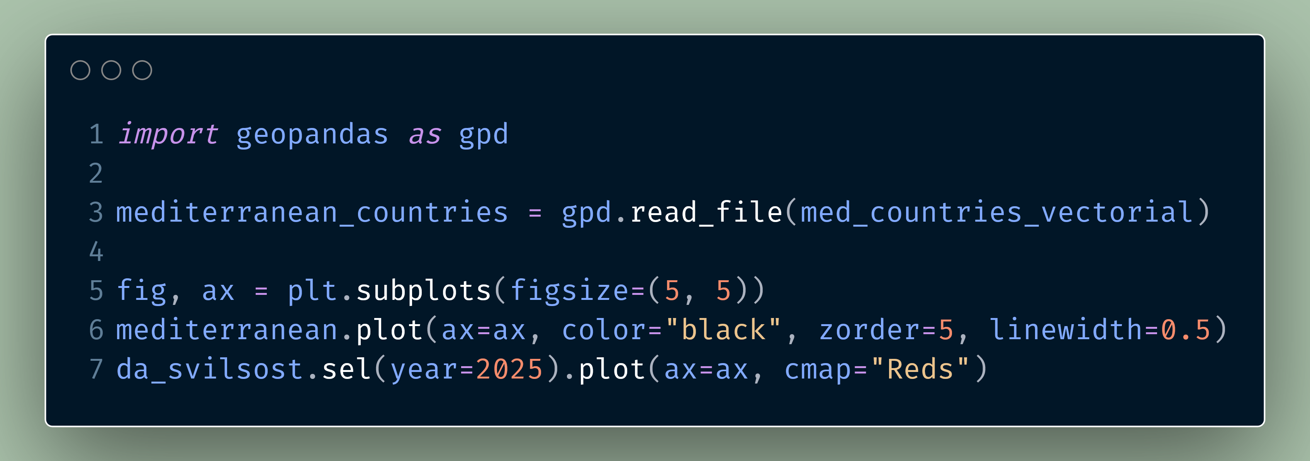

Slide 28
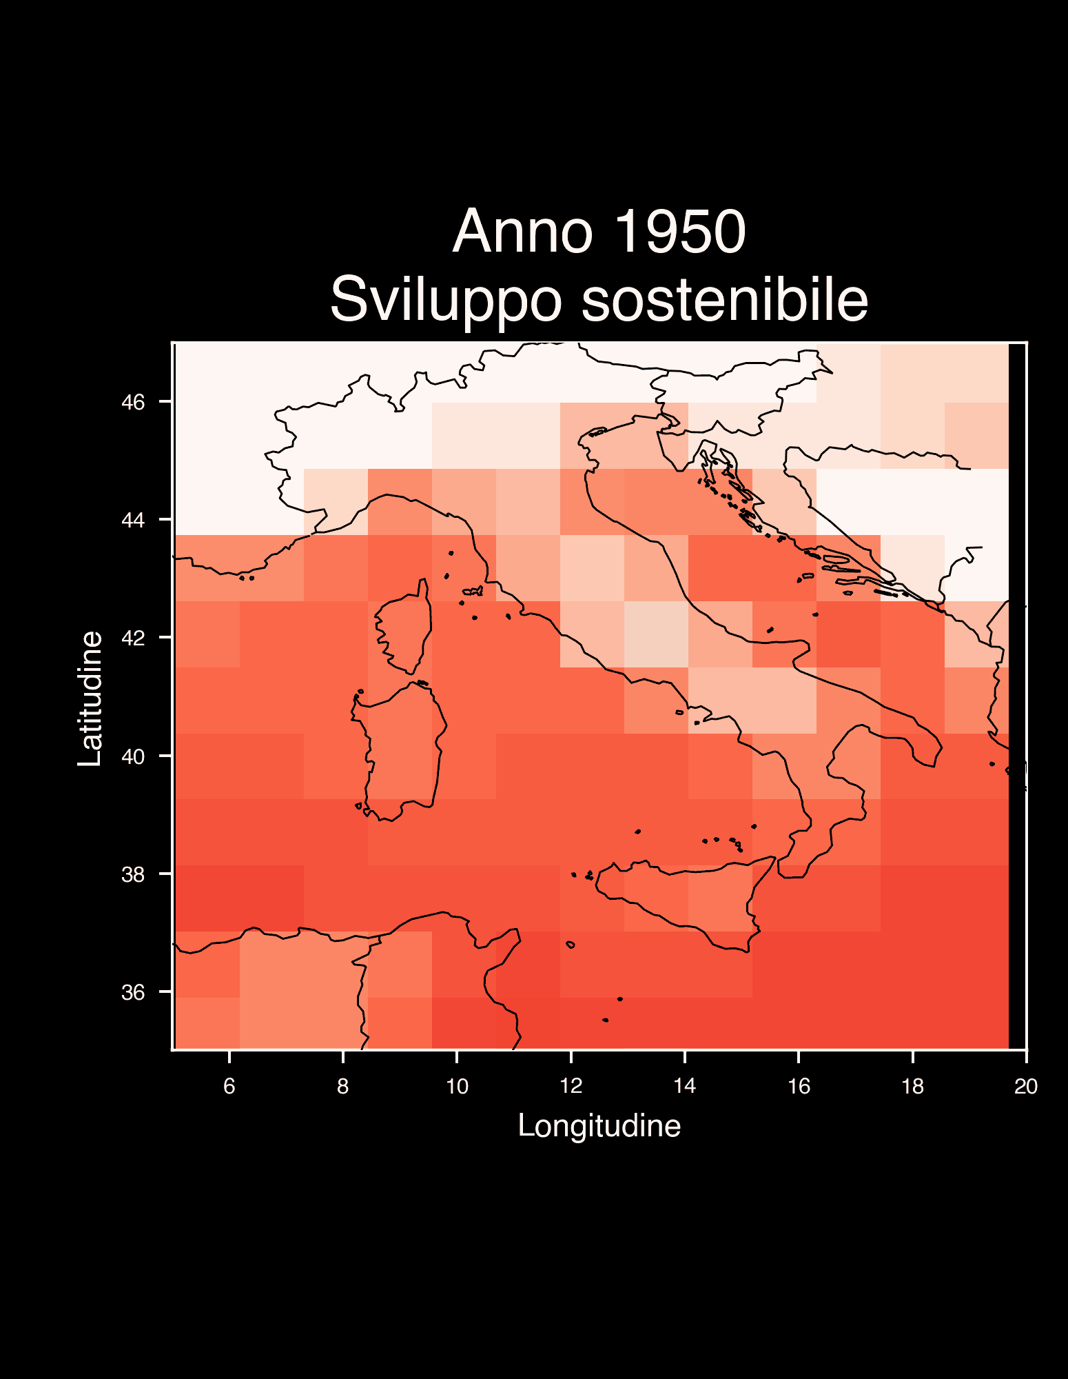
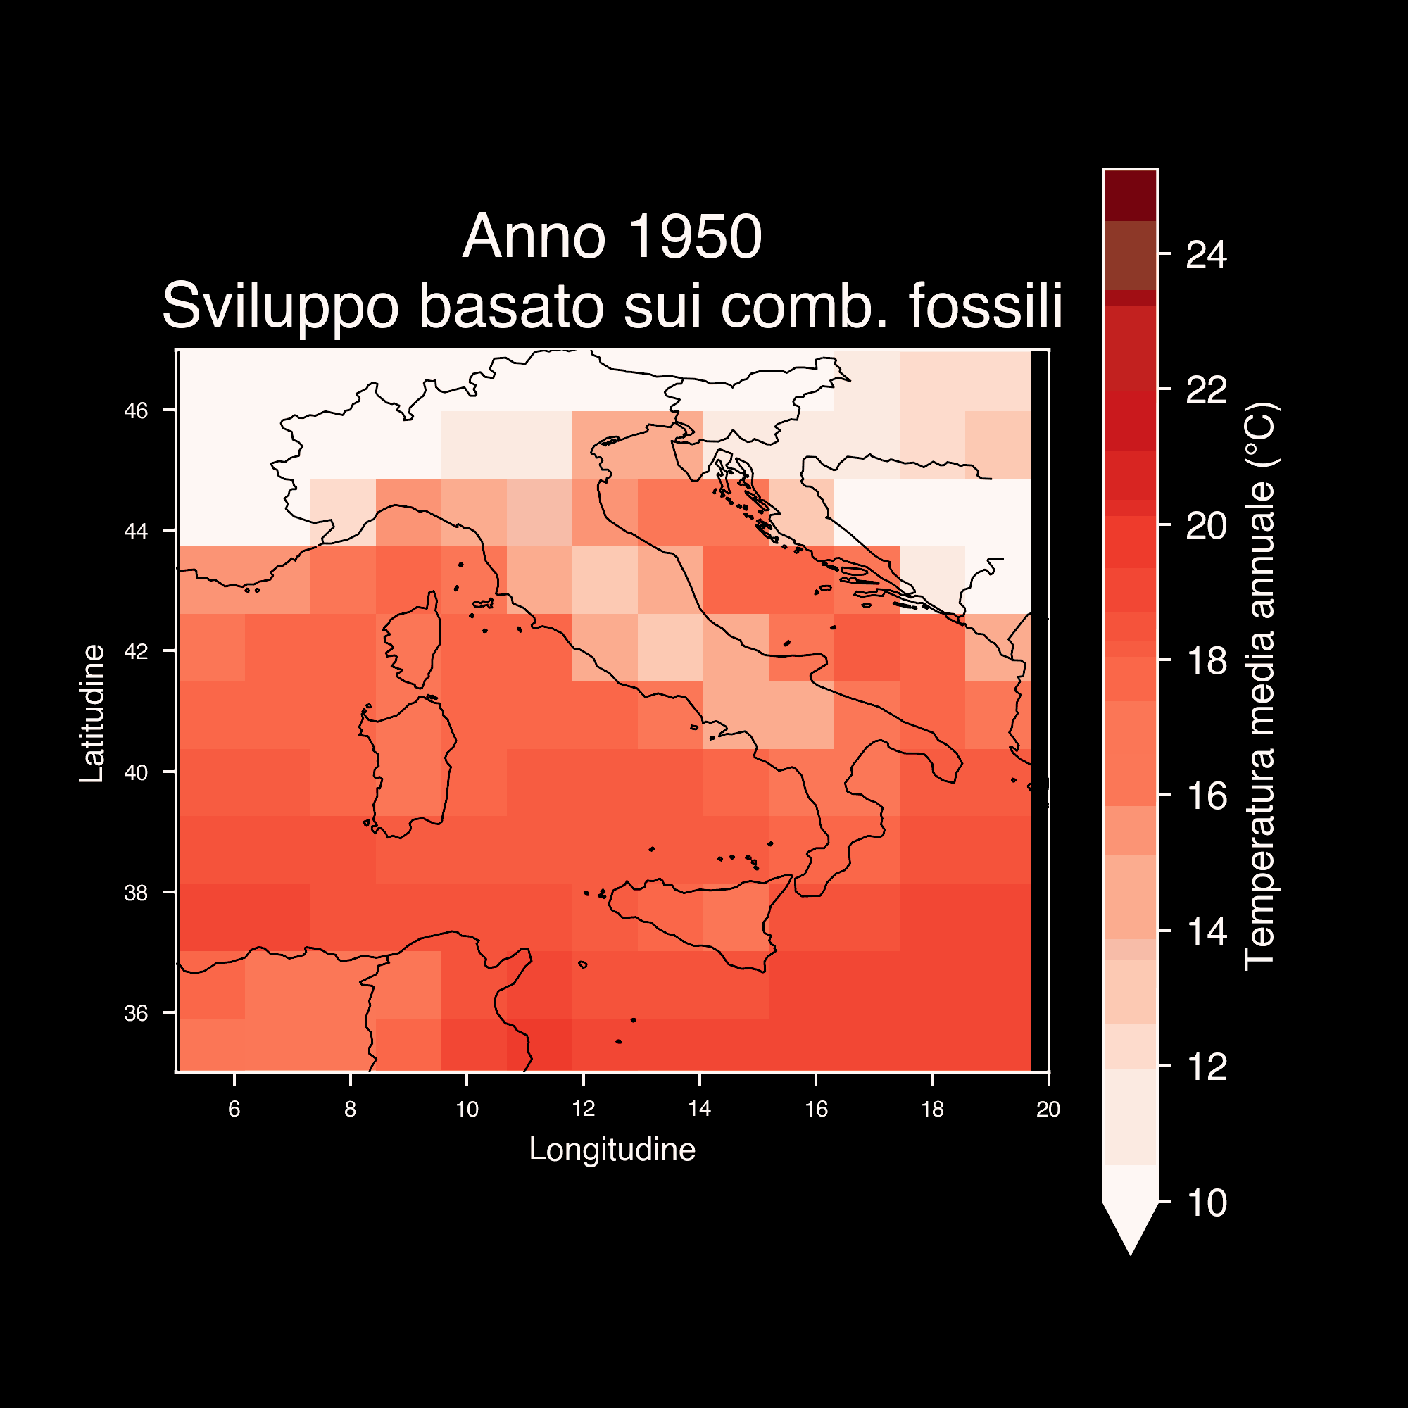

Slide 29
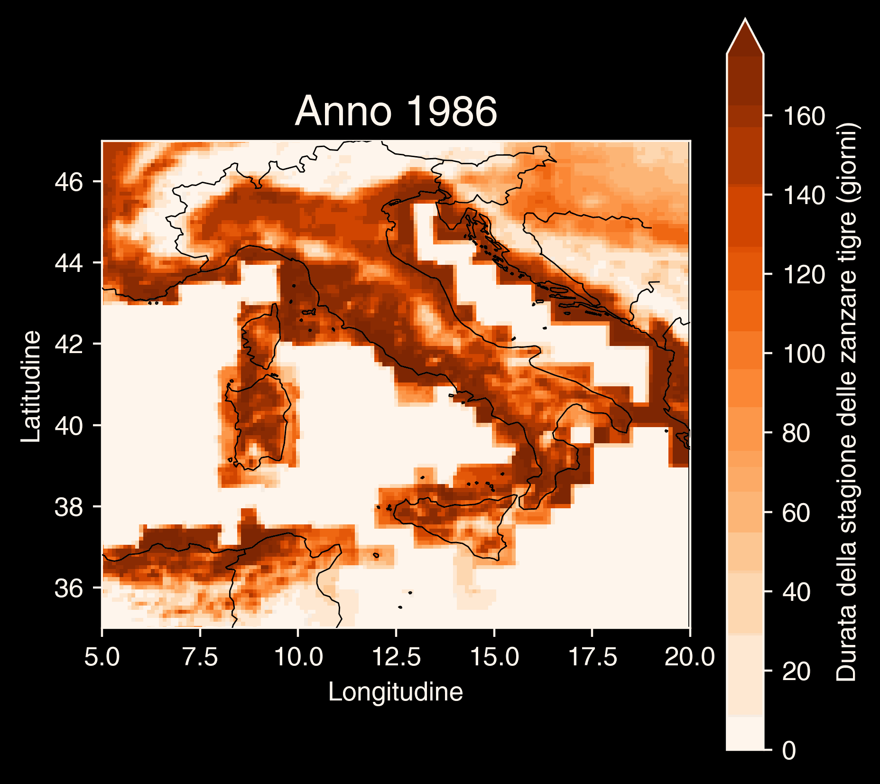
Copernicus Climate Change Service, Climate Data Store, (2019): Climatic suitability for the presence and seasonal activity of the Aedes albopictus mosquito for Europe derived from climate projections. Copernicus Climate Change Service (C3S) Climate Data Store (CDS). DOI: 10.24381/cds.d08ed09a

Slide 30

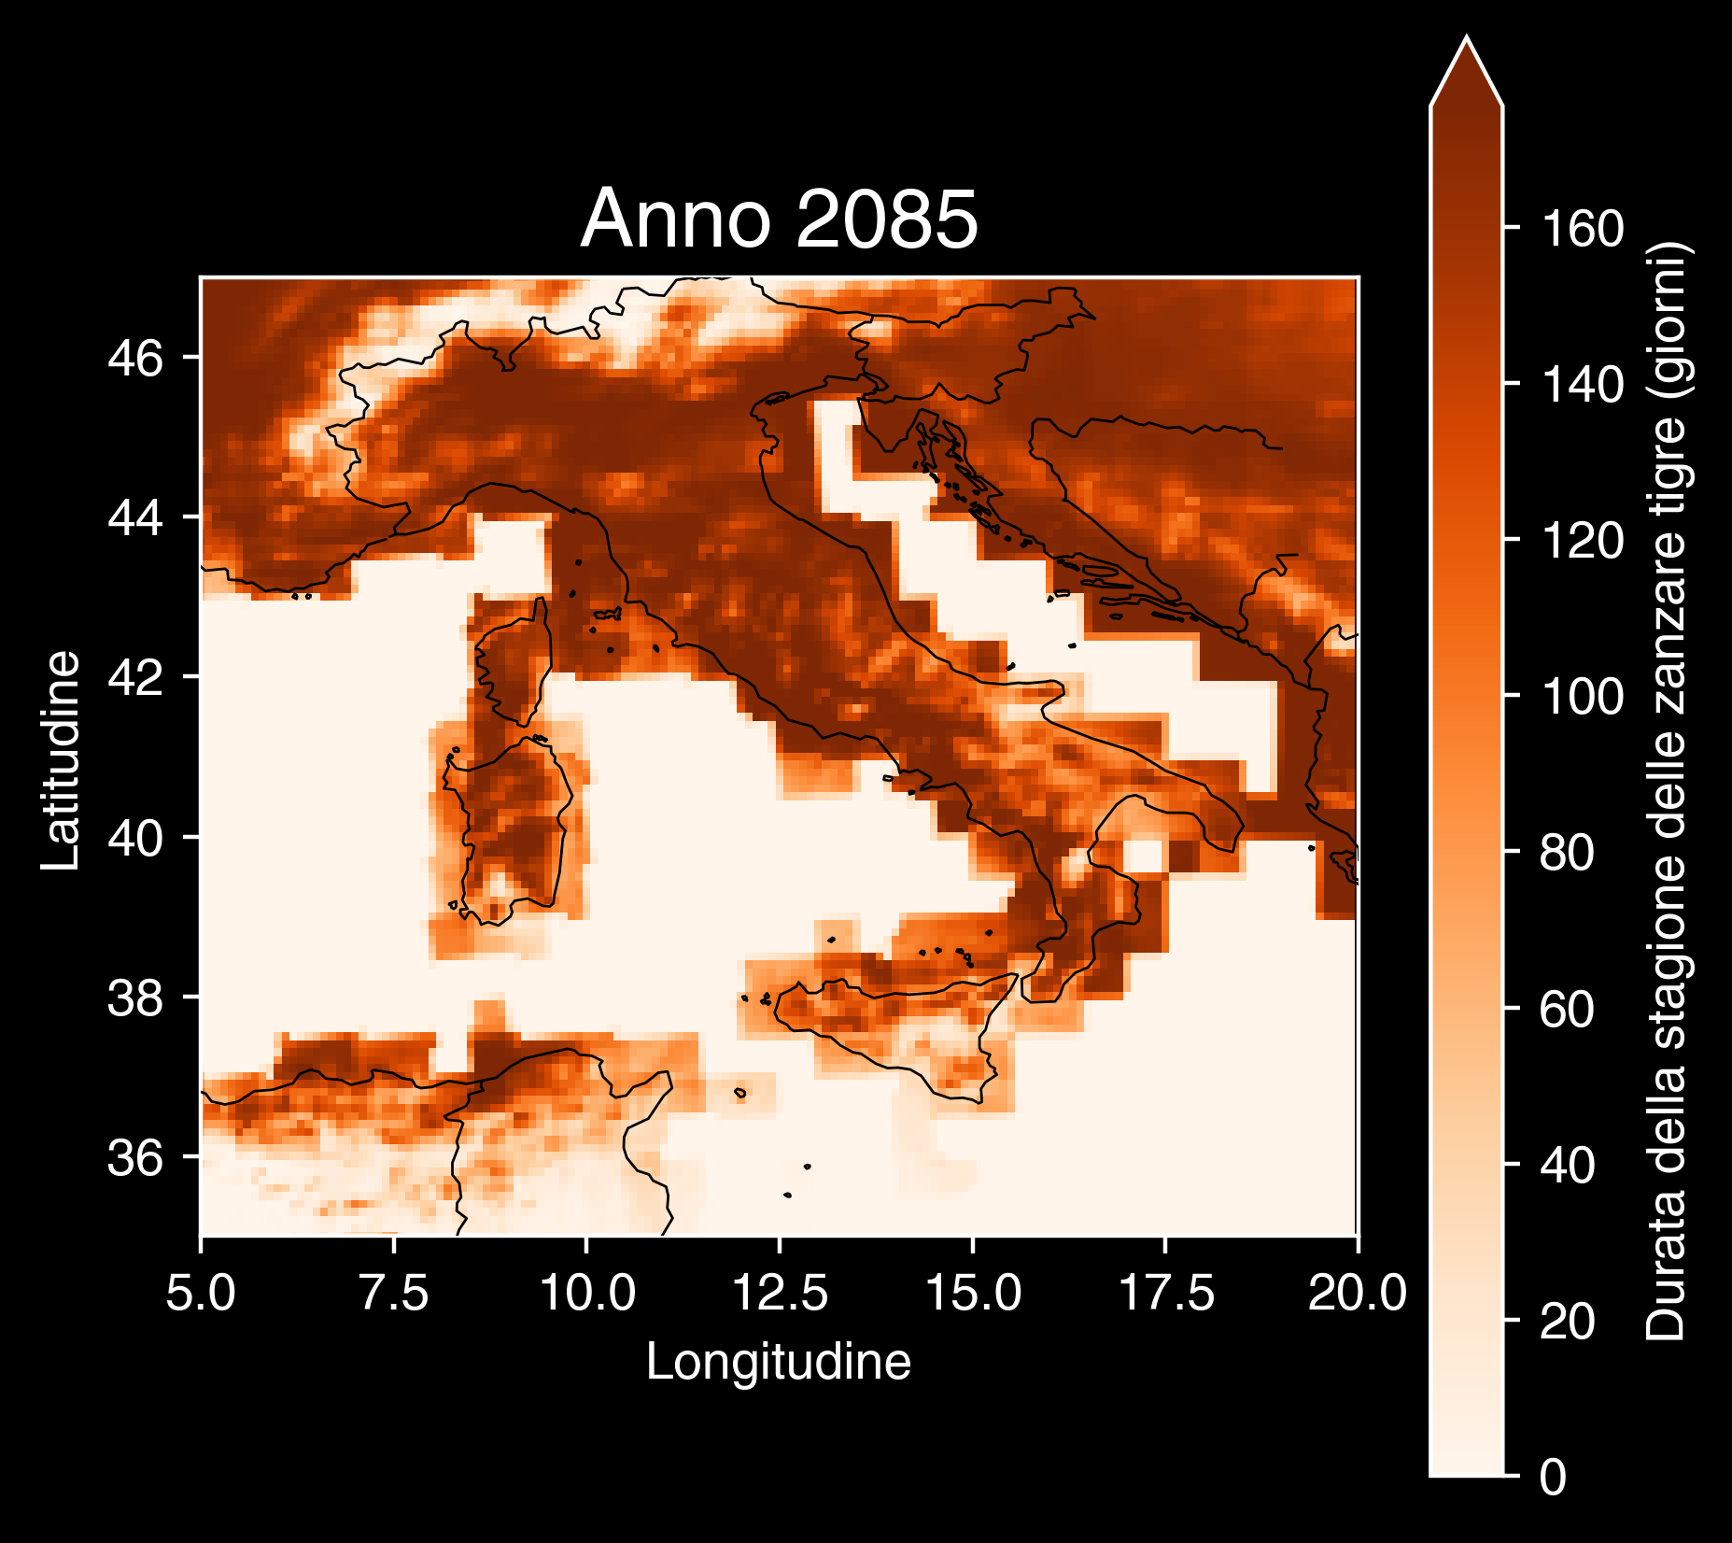
Copernicus Climate Change Service, Climate Data Store, (2019): Climatic suitability for the presence and seasonal activity of the Aedes albopictus mosquito for Europe derived from climate projections. Copernicus Climate Change Service (C3S) Climate Data Store (CDS). DOI: 10.24381/cds.d08ed09a

Slide 31
Le nostre scelte definiscono il cambiamento climatico

Slide 32
🥗Mangiamo consapevolmente.
🚲Muoviamoci leggeri/e.
🧑‍🚒Seguiamo la Protezione Civile locale.
🗳️Ricordiamo l’importanza del nostro voto.

Slide 33

https://github.com/Robin-Castellani/pyconit25-future-climate-change

Slide 34

Feedback 👐

Slide 35
Qualcosa in più...
Perché non si sa mai...
😏

Slide 36
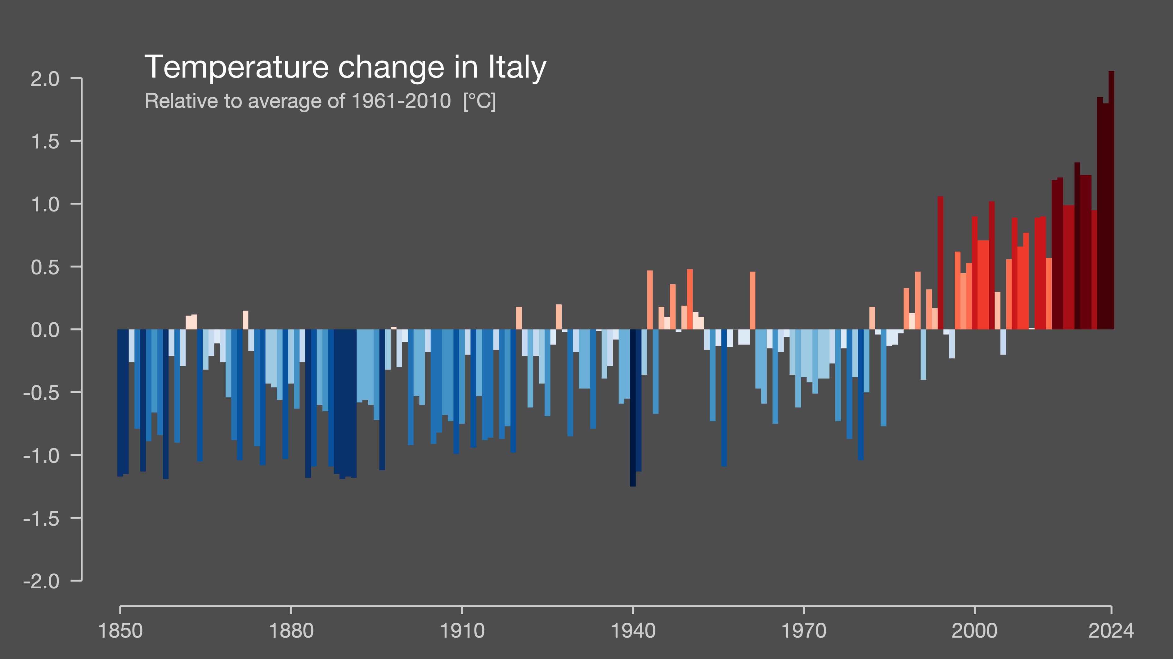
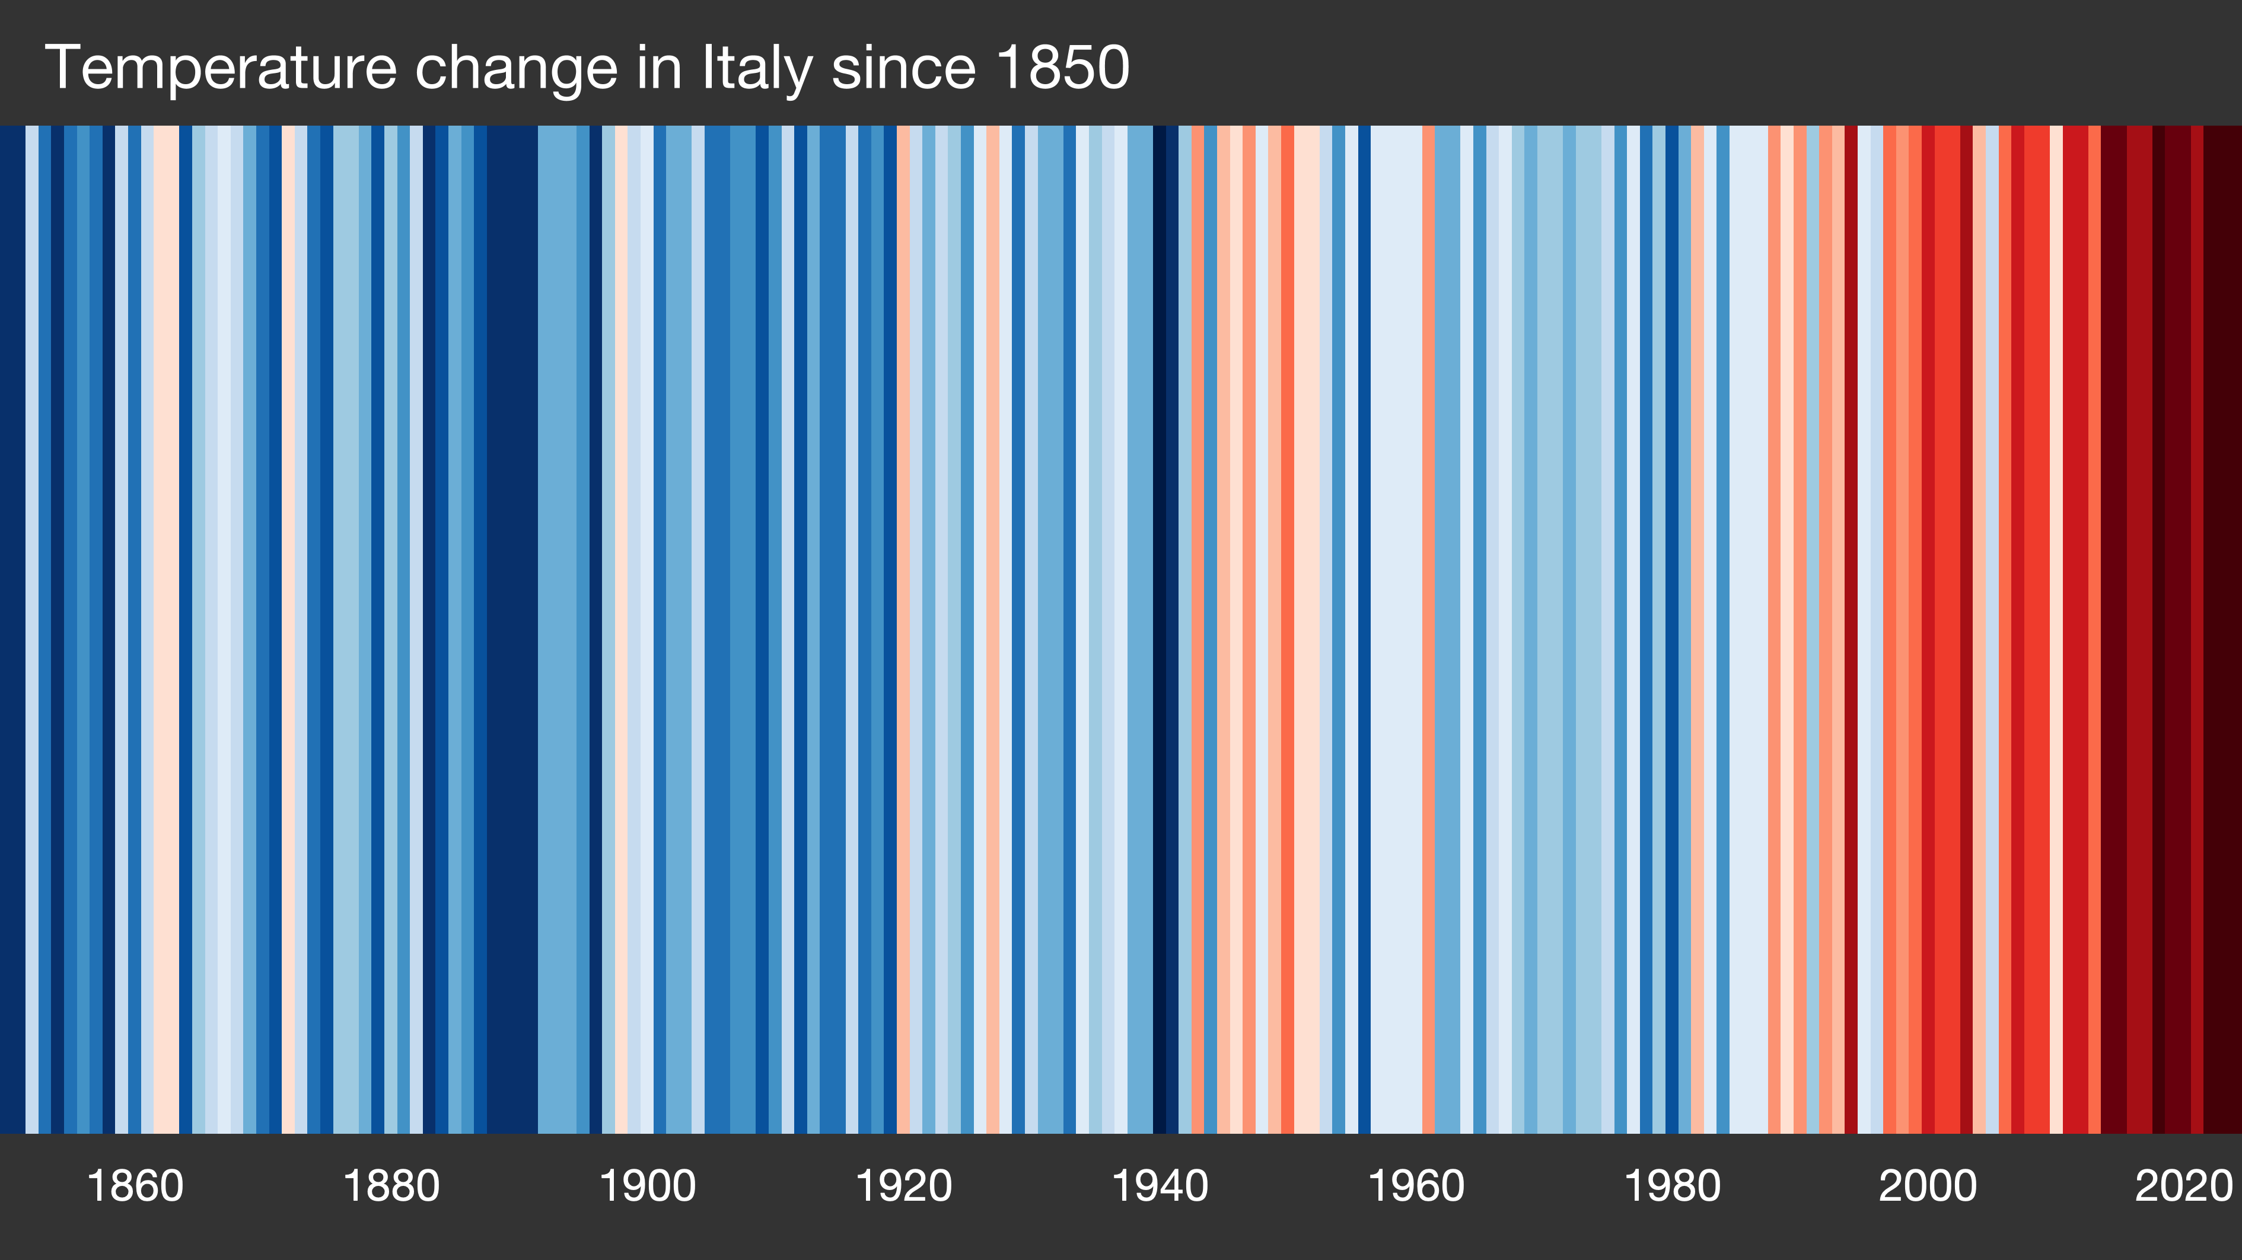
Showyourstripes.info by Ed Hawkins, University of Reading

Slide 37
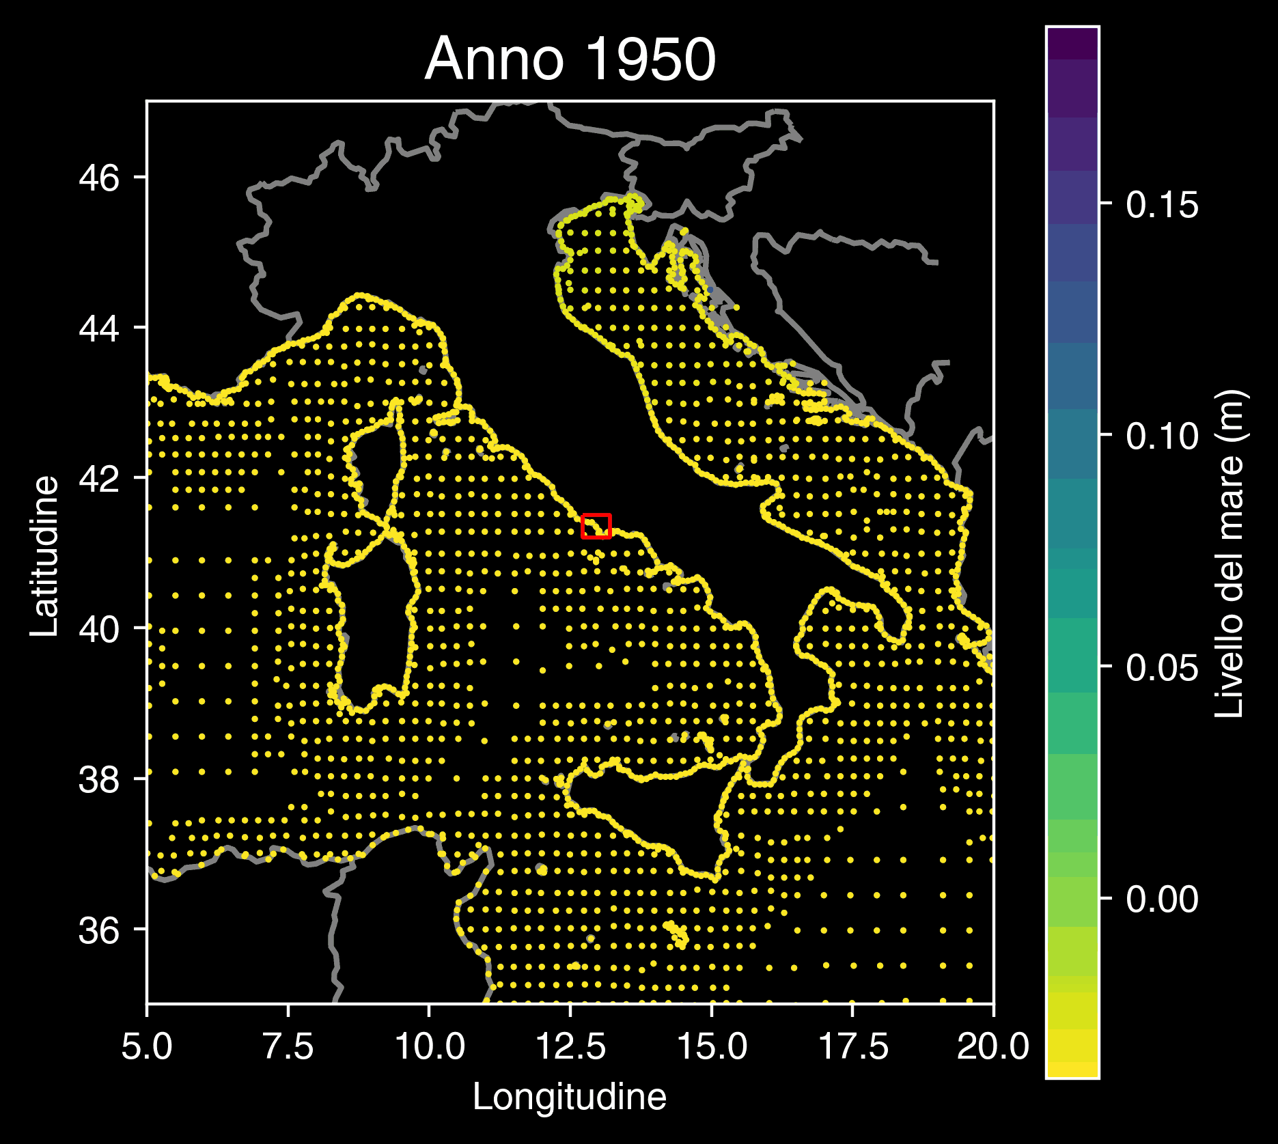
Copernicus Climate Change Service (2022): Global sea level change indicators from 1950 to 2050 derived from reanalysis and high resolution CMIP6 climate projections. Copernicus Climate Change Service (C3S) Climate Data Store (CDS). DOI: 10.24381/cds.6edf04e0

Slide 38
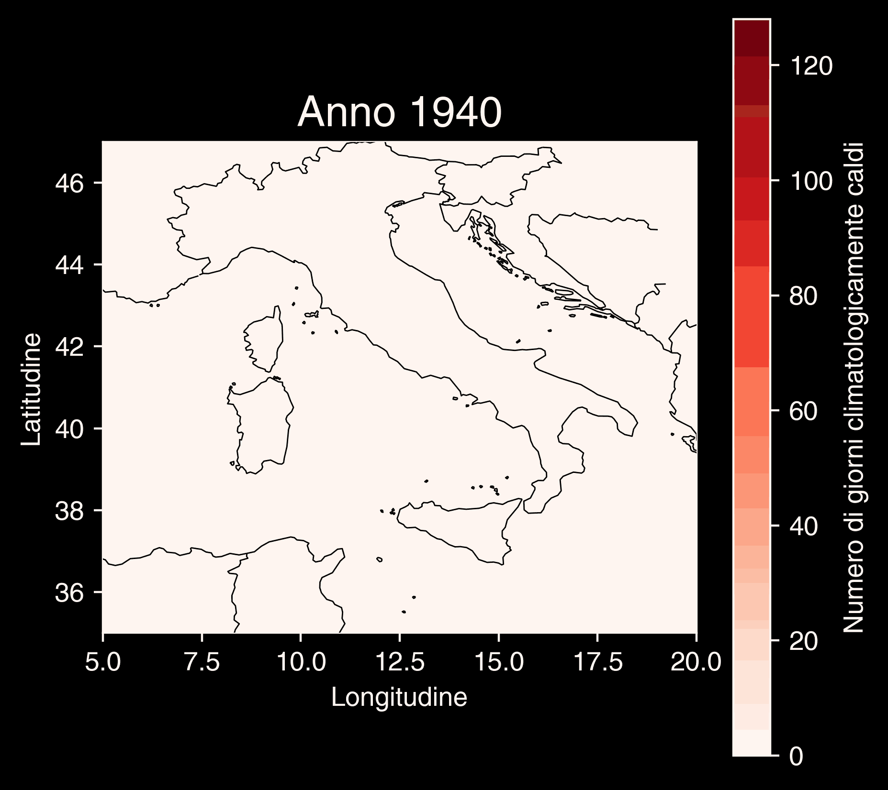
Copernicus Climate Change Service (C3S), Climate Data Store (CDS), (2024): Climate indicators for Europe from 1940 to 2100 derived from reanalysis and climate projections, Copernicus Climate Change Service (C3S) Climate Data Store (CDS).

Slide 39
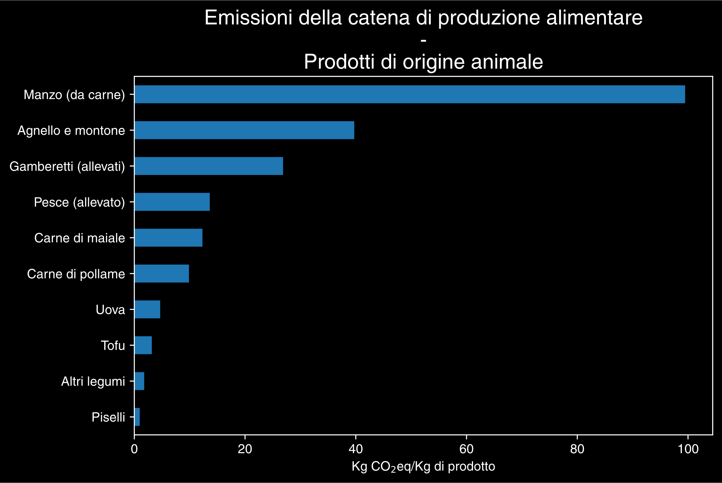
Hannah Ritchie, Pablo Rosado and Max Roser (2022) - “Environmental Impacts of Food Production” Published online at OurWorldinData.org. Retrieved from: 'https://ourworldindata.org/environmental-impacts-of-food' [Online Resource]

Slide 40
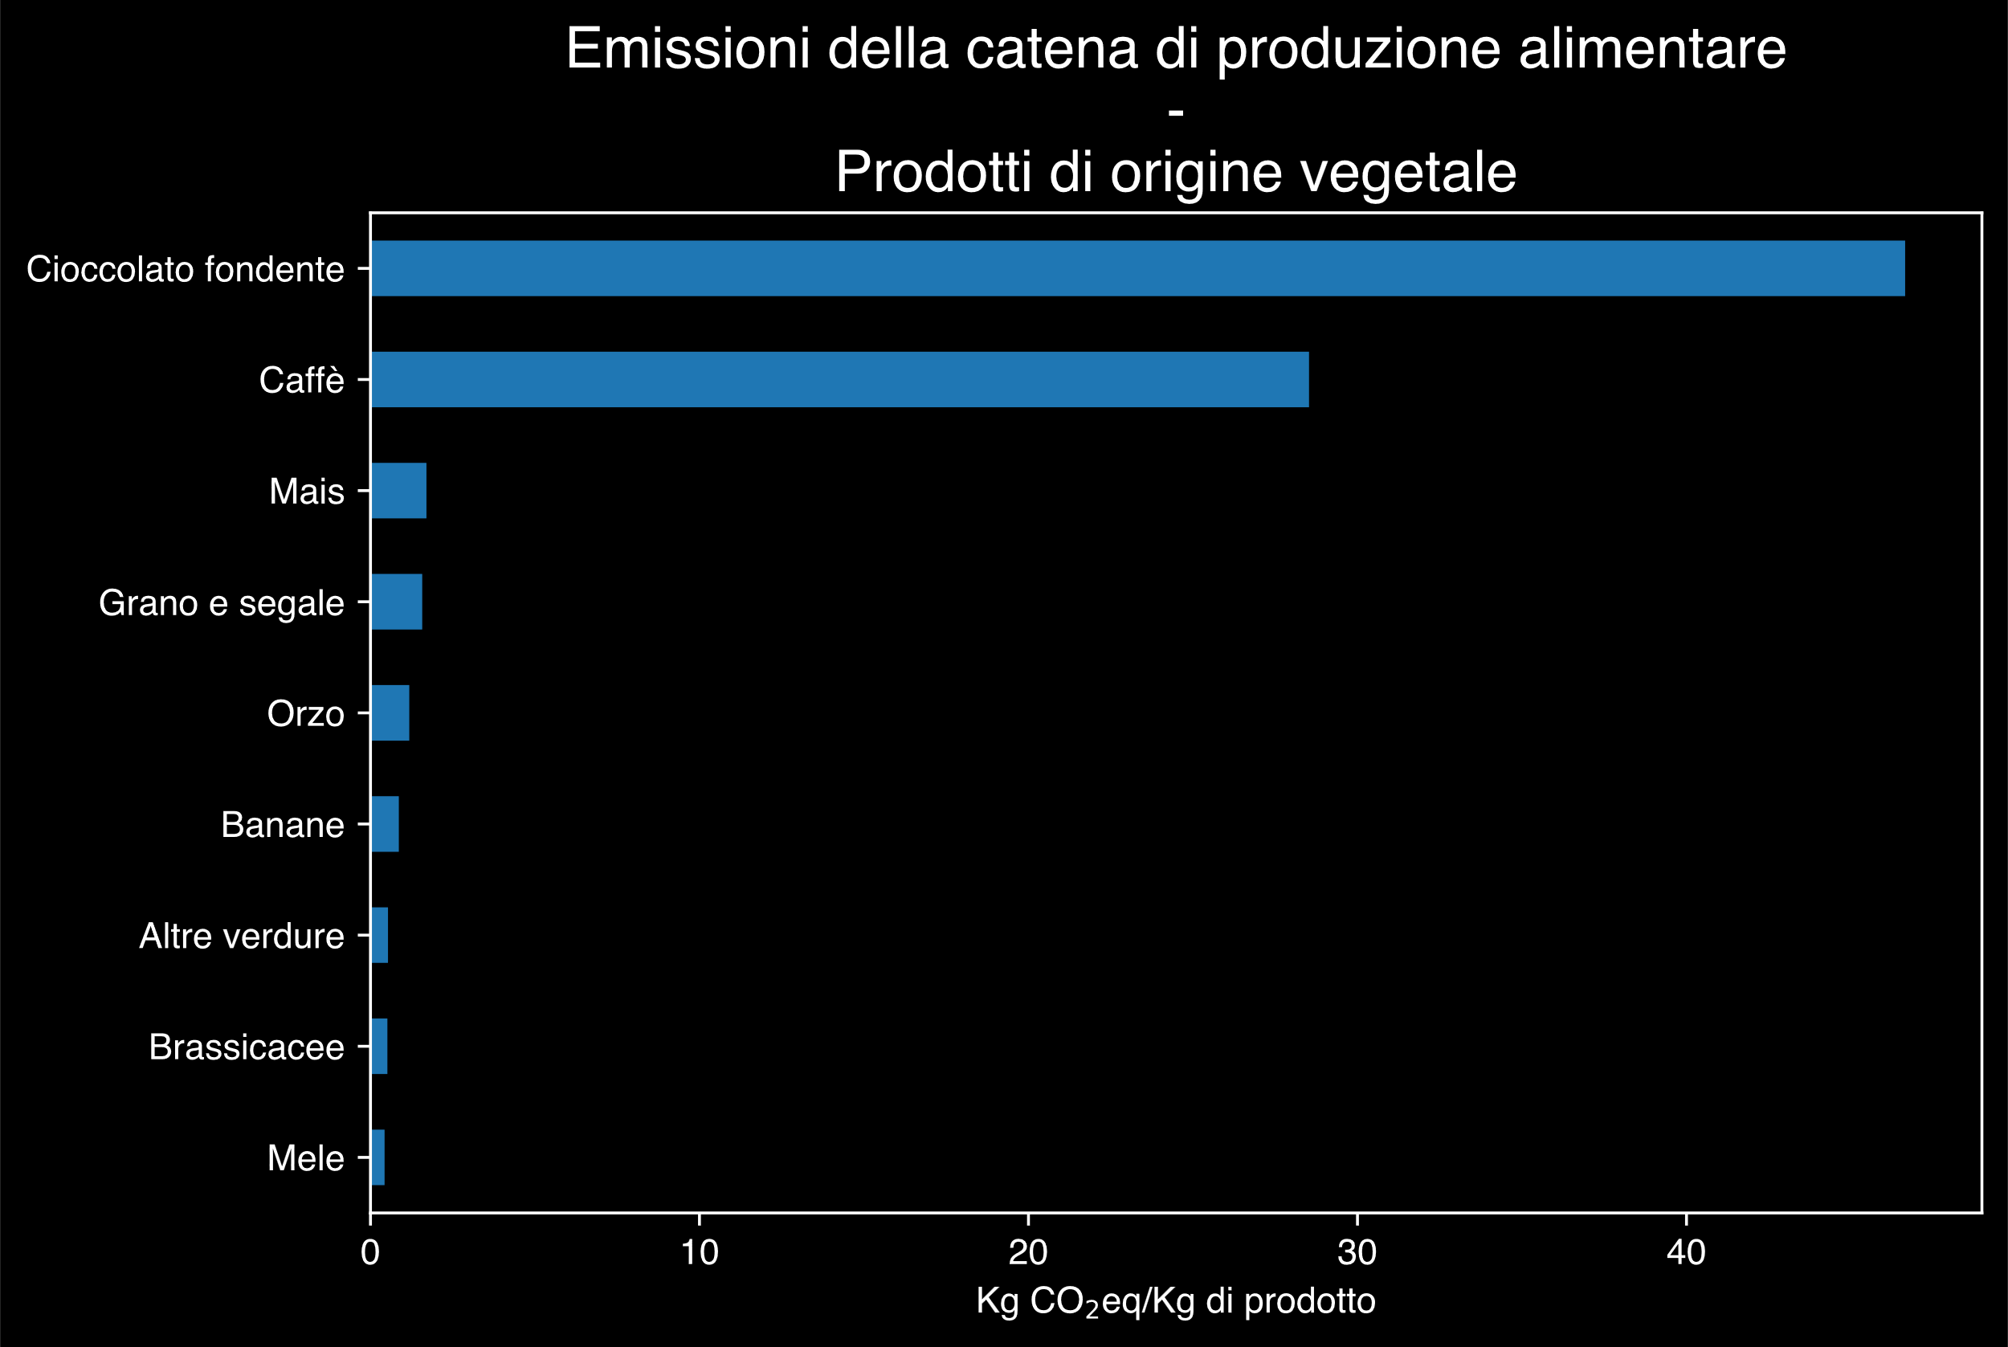
Hannah Ritchie, Pablo Rosado and Max Roser (2022) - “Environmental Impacts of Food Production” Published online at OurWorldinData.org. Retrieved from: 'https://ourworldindata.org/environmental-impacts-of-food' [Online Resource]

Slide 41
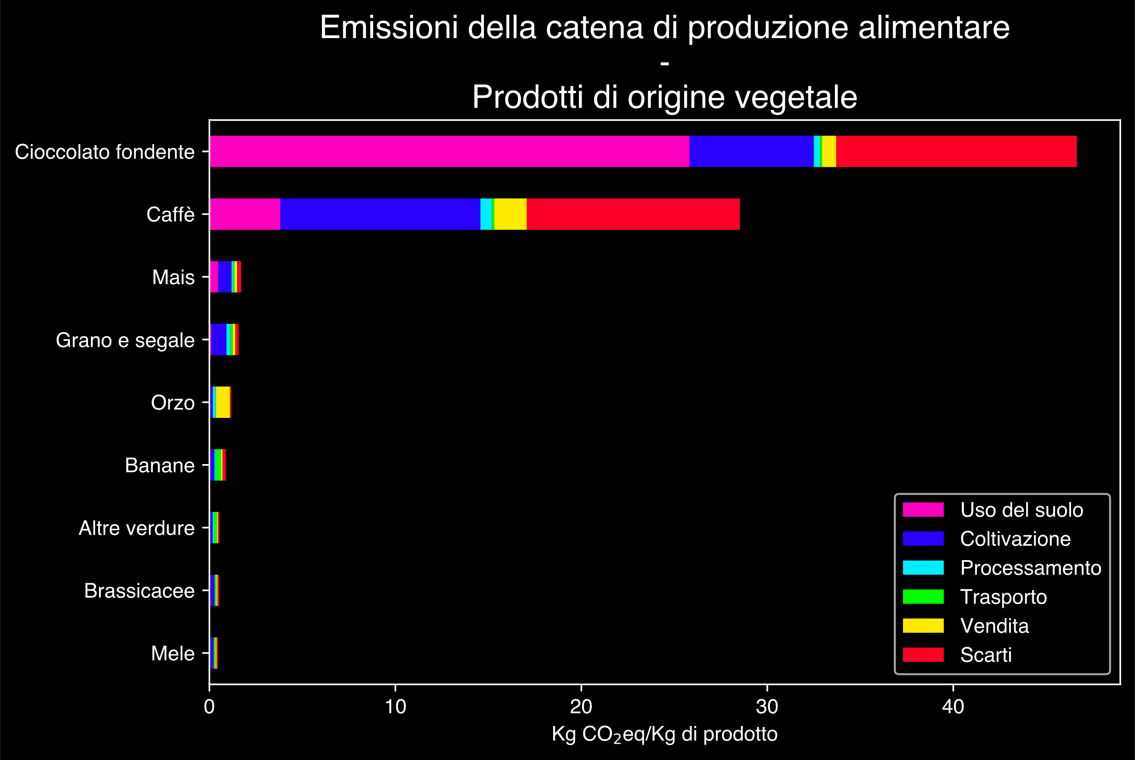
Hannah Ritchie, Pablo Rosado and Max Roser (2022) - “Environmental Impacts of Food Production” Published online at OurWorldinData.org. Retrieved from: 'https://ourworldindata.org/environmental-impacts-of-food' [Online Resource]

Slide 42
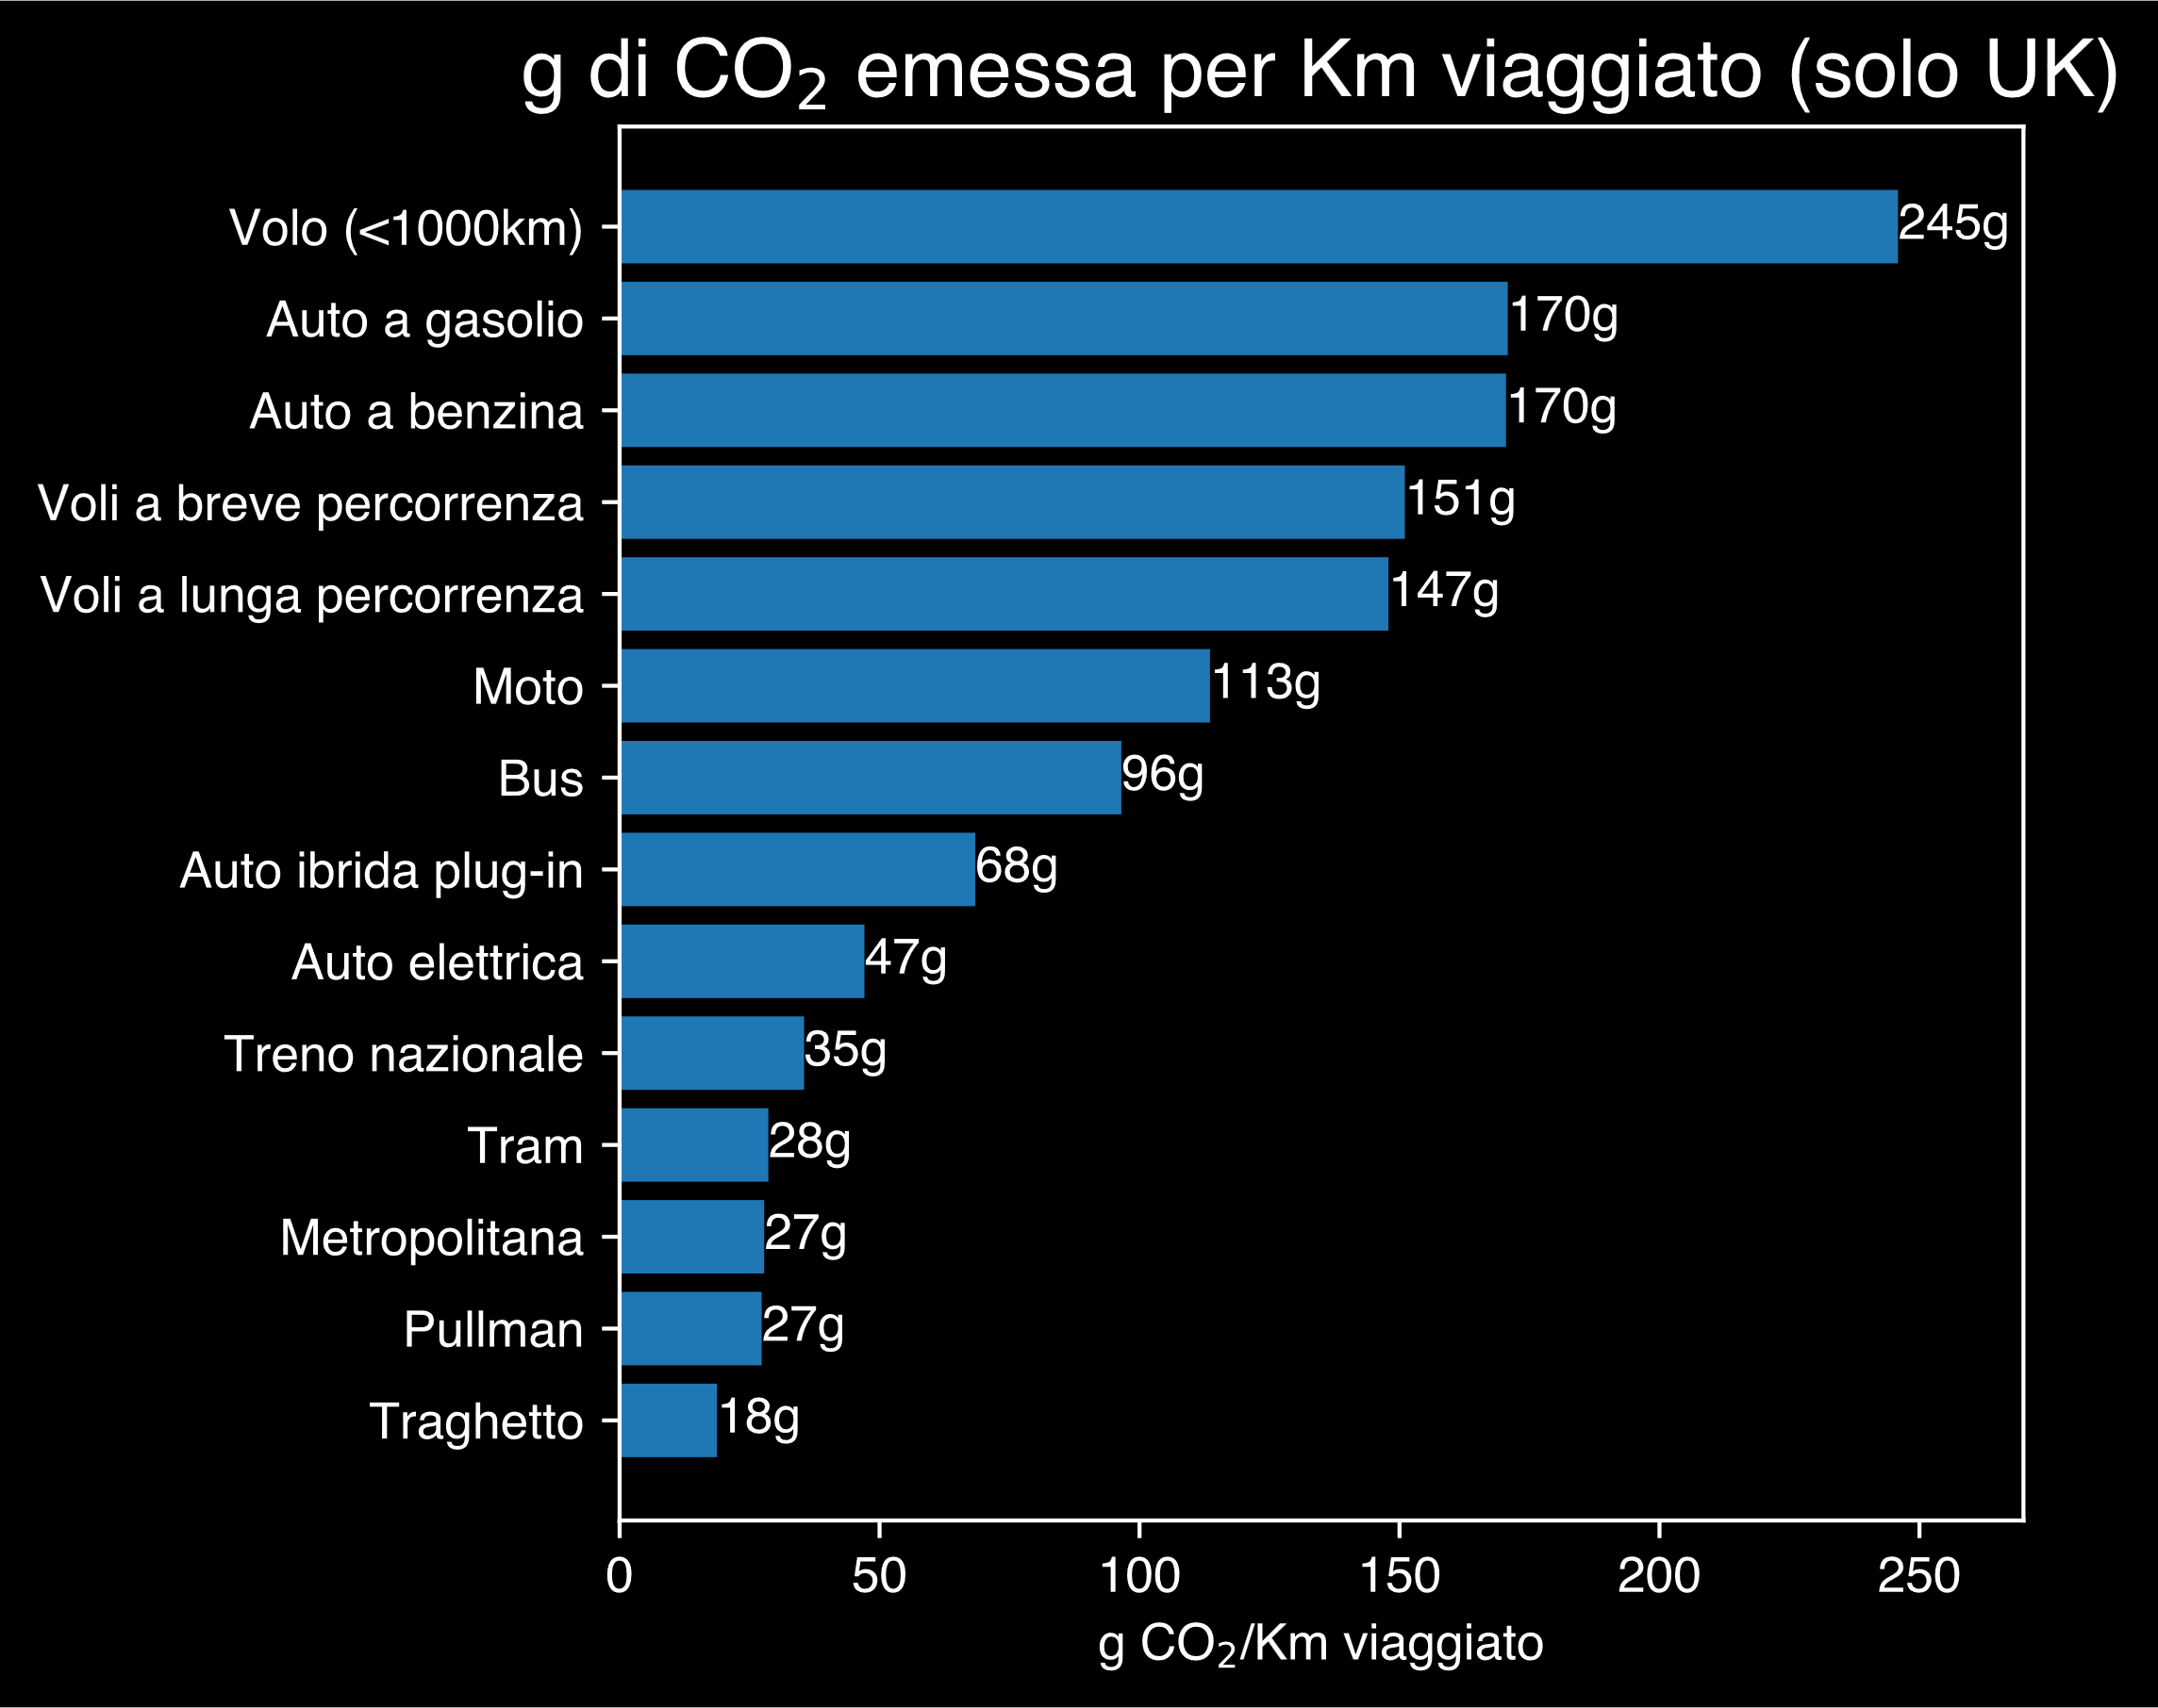
Hannah Ritchie (2023) - “Which form of transport has the smallest carbon footprint?” Published online at OurWorldinData.org. Retrieved from: 'https://ourworldindata.org/travel-carbon-footprint' [Online Resource]

